Slide 1

Georgia High School Association
Referee
New Member
Clinic
By Association
Clinicians

Slide 2




Georgia High School Association
Please Turn off ALL electronic devices
EXCEPT
if being used for note-taking

Slide 3
Basic Principles
  SAFETY
  PARTICIPATION
  LEARNING

Slide 4

GHSA
DUAL SYSTEM
OF CONTROL

Slide 5
Responsibilities of Officials
Enforce Laws of the Game
Equal Authority
Pre-game Duties
Start Clock
Make the Call I - IV
Application of Advantage
General Patterns I - V

Slide 6

Enforce Laws of the Game......
.........Decide disputed points
Caution
Disqualify

Slide 7
Equal Authority
Both officials shall have EQUAL AUTHORITY and
responsibilities in the calling of fouls and violations on any part of the field at any time.

Slide 8

Pre-game Duties
Check List
Pre-game Conference
Field Markings and Nets
Instructor scorers, Timers, and Assistant Referees
Equipment of players
Goalkeepers’ Jerseys
Captains’ Numbers

Slide 9
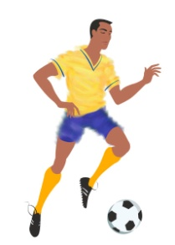
Pre-game For Clock Operator
Start Clock
Legally kicked
Ball leaves hands
and legal enters the field of play
Ball hits ground

Slide 10
Making the Call I
Referee blows whistle to STOP play
Sometimes referee blows whistle to START play

Slide 11

Making the Call II
Referee who sees violation, whistles!
Sometimes referee blows the whistle to START play

Slide 12
NFHS RESTART PROCEDURES
SITUATION | NFHS OFFICIAL
START OF EACH HALF | TRAIL
KICKOFF AFTER A GOAL | TRAIL
DROP BALL | TRAIL
GOAL KICK | TRAIL
CORNER KICK | LEAD
PENALTY KICK | LEAD
FREE KICK | LEAD
THROW-IN | OFFICIAL RESPONSIBLE
The recommendation is have the lead official restart play, but always make eye- contact with the other official before restarting play!

Slide 13
Making the Call IV
T
Trail Referee
A
1. Moves even with ball
Placement
2. Covers Encroachments
Delays
A
D
G
A
D
D
Lead Referee
L
1. Moves ahead for play

Slide 14
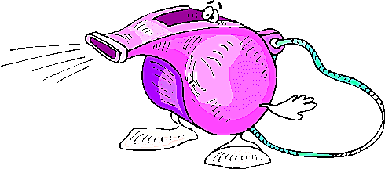
Application of Advantage
Play
On!

Slide 15
General Patterns I
L
T
a. Lead left
b. Lead right
T
L

Slide 16
General Patterns II
25 yds
L
A
D
D
D
G
A
A
D
A
T
Out of bounds responsibilities
Adjust to flow

Slide 17
General Patterns III
L
A
T
A
D
D
G
A
G
A
D
D
D
A
T
A
A
L
Flexible Pattern

Slide 18
Making the Call IV
L
G
D
G
A
A
D
D
A
L
D
D
A
D
A
A
A
T
T
Ball in deep
Lead off to corner
Lead out of way
Near goal line

Slide 19
General Patterns V
L
T
Work opposite – 2nd half

Slide 20
Set Positions
Start of Play
During Play
Free Kick
Corner Kick
Goalkeeper Clearance
Goal Kicks
Penalty Kick
Throw in
Drop Ball

Slide 21
Start of Play
T
A
D
A
D
A
D
L
During pre-game, decide who blows whistle for start of game and restarts
NFHS Rule Book states the Trail would start play with a whistle

Slide 22
G
G
L
D
D
D
L
D
A
A
D
A
A
D
D
A
D
A
T
A
T
A
During Play
Free Kick

Slide 23
L
G
T
G
T
T
D
A
D
A
L
D
Corner Kick
Goalkeeper Clearance

Slide 24
G
L
G
D
D
A
D
T
A
A
D
D
T
A
D
D
A
A
L
D
Goal Kick
Penalty Kick

Slide 25
Throw In
G
G
L
D
A
D
L
D
D
A
D
A
A
D
T
D
A
A
A
D
T
Trail moves toward line
Lead anticipates play

Slide 26
L
D
A
T
Drop
Ball

Slide 27
N.F. Dual System of Control
ADVANTAGES
MORE COVERAGE WITH WHISTLE
BOTH HAVE EQUAL AUTHORITY
  - NO NEED TO LOOK (BE CAREFUL)
SEE FIELD FROM DIFFERENT ANGLES
EACH OFFICIAL CALLS WHAT HE SEES
  AWAY OFFICIAL SHOULD HESITATE
OFFSIDE JUDGE HAS WHISTLE
OFF BALL COVERAGE BETTER
PLAY KEPT BETWEEN TWO OFFICIALS

Slide 28
N.F. Dual System of Control
HELPFUL HINTS
WORK AS A TEAM !!EYE CONTACT!!
RESPECT EACH OTHER'S ABILITY
  DON'T DISPLAY LACK OF CONFIDENCE
MAKE CALLS WHEN YOU SEE THEM
  MAKE SURE YOU ARE IN GOOD POSITION
COVER EACH OTHER
KEEP MOVING....DON'T BE SCREENED OUT
LEAD STAYS AHEAD OF PLAY AND OUT OF FLOW

Slide 29
N.F. Dual System of Control
HELPFUL HINTS
LEAD CALLS OFFSIDE
TRAIL MAY PINCH IN OFF TOUCH LINE
  KEEP PLAY BOXED IN
FUNCTION AS A TEAM
  LOOK AT EACH OTHER
CHANGE TOUCH LINES AT HALFTIME
AT END OF HALF, MEET AT CENTER THEN LEAVE

Slide 30
N.F. Dual System of Control
HELPFUL HINTS
TWO WHISTLES…TOGETHER
IGNORE EACH OTHER
CONFERENCE TOGETHER
EYE COMMUNICATIONS
  WITH HAND SIGNALS
  MORE SERIOUS
CLOSEST REFEREE

Slide 31
N.F. Dual System of Control
SUMMARY
INTENSITY - - BE INVOLVED!!
SILENT SIGNALS
KNOW WHERE THE OTHER REFEREE IS
PERIPHERAL VISION

Slide 32
!!!! Break !!!!
10
Minute
Break

Slide 33


FEDERATION DIFFERENCES
vs.

Slide 34
FEDERATION DIFFERENCES
RULE 1 - THE FIELD OF PLAY
  FIELD LENGTH 100/120 RECOMMENDED 110
  FIELD WIDTH 55/80 RECOMMENDED 65
  LINE WIDTH 4" (DISTINCTIVE COLOR)
  (NON-CAUSTIC MATERIALS)
  2’ PENALTY LINE OR 9” SPOT
  GOAL POSTS MAY BE PADDED – 1” THICK X 72” HEIGHT
  NETS SHALL BE ATTACHED

Slide 35
FEDERATION DIFFERENCES
RULE 1 - THE FIELD OF PLAY
  OFFICIAL AND TEAM AREAS
SAME SIDE (RECOMMENDED DURING SEASON & MANDATED FOR ALL PLAY-OFFS)
    OFFICIAL - 5 YARDS FROM HALF LINE
    TEAM - 10-30 YARDS FROM HALF LINE
    10 FEET FROM TOUCHLINE
OPPOSITE SIDE
    TEAM - 10 YARDS FROM THE HALF LINE
    10 FEET FROM TOUCHLINE
    BENCHES WILL BE ON A DIAGONAL FROM EACH OTHER
  SPECTATORS
    10 FEET FROM TOUCH LINE AND TEAM/OFFICIAL AREA
    NOT PERMITTED DIRECTLY BEHIND GOAL UNLESS IN BLEACHERS

Slide 36
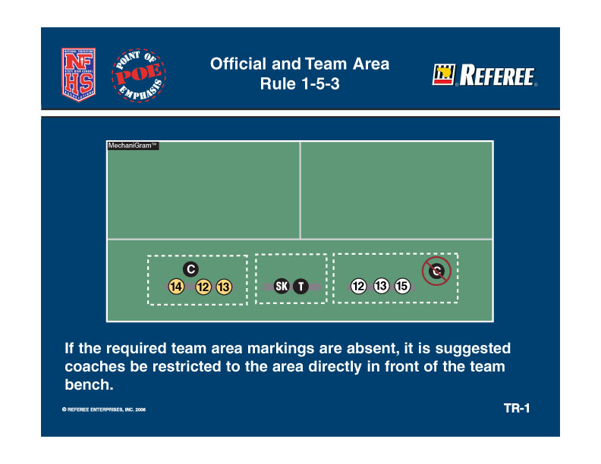
FEDERATION DIFFERENCES
RULE 1 - THE FIELD OF PLAY

Slide 37
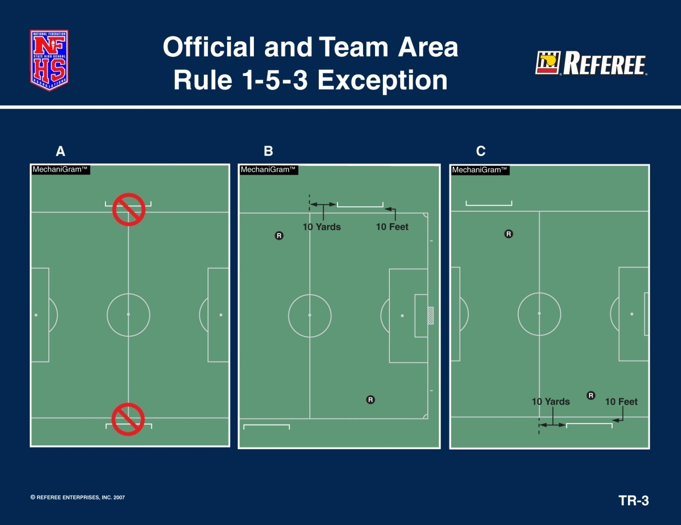
FEDERATION DIFFERENCES
RULE 1 - THE FIELD OF PLAY

Slide 38
FEDERATION DIFFERENCES
RULE 2 - THE BALL
  THE BALL
    HOME TEAM RESPONSIBILITY
    3 OR MORE SIMILAR
    NFHS LOGO ON THE BALLS
    (IF NOT, REFEREE CHOOSES)
  IF BALL BECOMES DEFLATED,
    DEAD WHERE LAST PLAYED EXCEPT
    IN THE GOAL AREA
  DROP BALL BETWEEN
    2 OPPOSING PLAYERS
  AT LEAST TWO BALL HOLDERS
Notes:
The big difference is in FIFA it is where the ball becomes deflated and HS where last played.

Slide 39
FEDERATION DIFFERENCES
RULE 3 - THE PLAYER & SUBSTITUTIONS
EACH TEAM SHALL HAVE A CAPTAIN AND HE MAY ADDRESS THE OFFICIALS
TEAM ROSTER PRESENTED BY COACH OR PLAYER
  5 MINUTES PRIOR TO START THE GAME
  NAMES MAY BE ADDED AFTER THE START OF PLAY
IF TEAM CONSUMES TIME FOR SUB..…
IF REPORTED AND WANTS TO SUB, ONCE BECKONED SHALL ENTER UNLESS:
  END OF PERIOD
  GOAL SCORED
A SUBSTITUTE BECOMES A PLAYER WHEN HE/SHE IS BECKONED ONTO THE FIELD OF PLAY
THE DEPARTING PLAYER DOES NOT HAVE TO BE OFF THE FIELD TO BECKON ON THE SUBSTITUTE

Slide 40
FEDERATION DIFFERENCES
RULE 3 - THE PLAYER & SUBSTITUTIONS
SUBSTITUTES - EITHER TEAM OFF THE BENCH
  BETWEEN PERIODS
  AFTER GOAL (MUST WAIT TO BE BECKONED BY REFEREE)
  INJURED PLAYER ATTENDED ON THE FIELD (ATTENDED PLAYER MUST LEAVE THE FIELD) AND MAY BE SUBSTITUTED (MUST WAIT TO BE BECKONED BY REFEREE)
SUBSTITUTES - EITHER TEAM, IF PRIOR REPORTED
  CAUTION (CAUTIONED PLAYER MUST LEAVE AND MAY BE SUBSTITUTED FROM OFF THE BENCH)
  DISQUALIFIED (STILL PLAY SHORT)
  GOAL KICK
SUBSTITUTES - TEAM POSSESSION , IF PRIOR REPORTED
  THROW IN (OPPONENT, IF TEAM IN POSSESSION SUBSTITUTES)
  CORNER KICK (OPPONENT, IF TEAM IN POSSESSION SUBSTITUTES)
MUST REPORT PRIOR TO DEAD BALL (NEAREST OFFICIALAT HALF LINE IF NO SCORER TABLE)
INJURED PLAYER APPEARS UNCONSCIOUS...

Slide 41
FEDERATION DIFFERENCES
RULE 3 - THE PLAYER & SUBSTITUTIONS
Prior to entering the game after a goal is scored or when a player is injured and removed, players are required to check in with the scorer/timer – or referee if there is no scorer/timer. After checking in, the player must wait until he or she is beckoned onto the field by the referee.

Slide 42
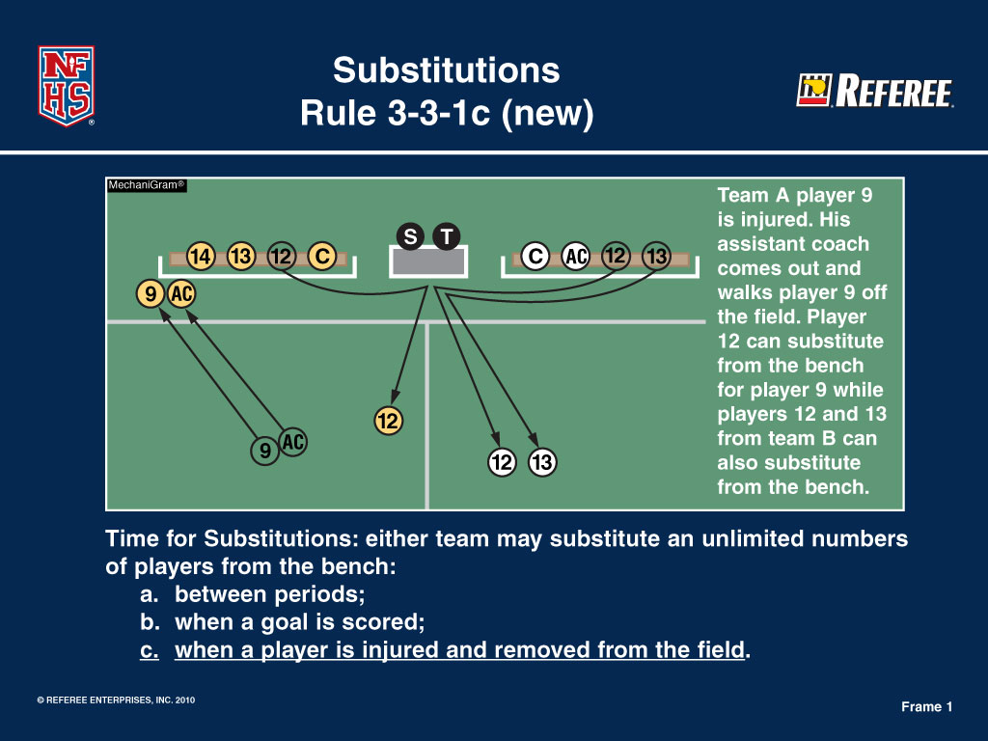
FEDERATION DIFFERENCES
RULE 3 - THE PLAYER & SUBSTITUTIONS

Slide 43

FEDERATION DIFFERENCES
RULE 3 - THE PLAYER & SUBSTITUTIONS
Rule 3-3-1c1, 4-2-8
Wording of “athletic trainer” and “MD/DO” are changed to “appropriate health-care professional” to allow each association to follow state law.

Slide 44
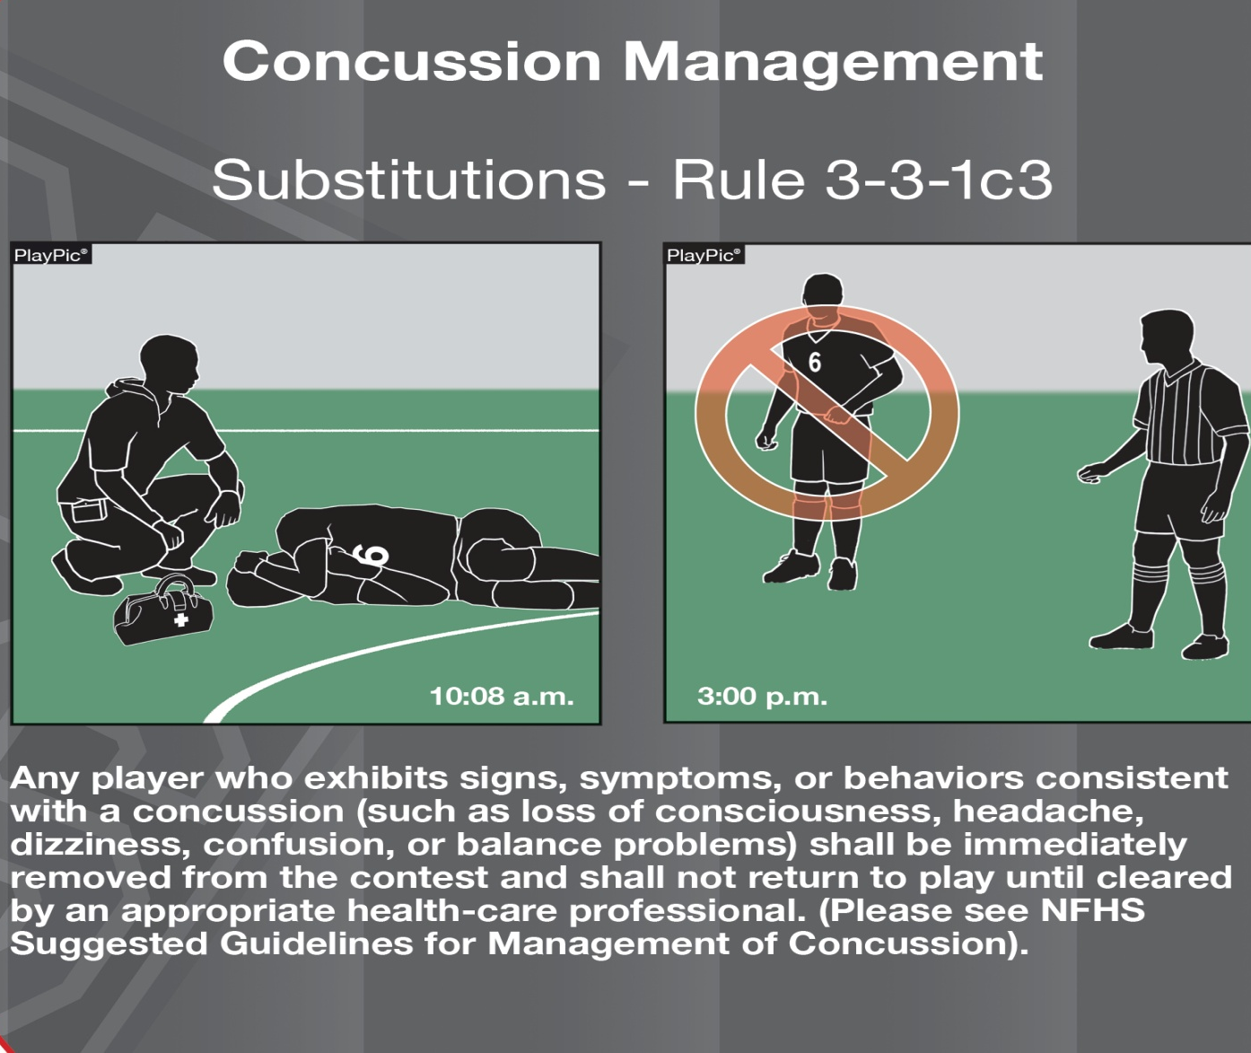
FEDERATION DIFFERENCES
RULE 3 - THE PLAYER & SUBSTITUTIONS
Notes:
Note the time difference on each slide

Slide 45
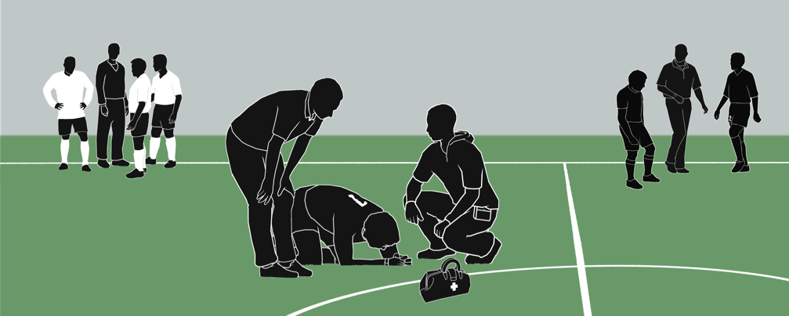
Substitutions
Rule 3-3-2b(1)
PlayPic®
Limitations on coaching during injury situations were removed. Whether a short injury stoppage or a prolonged stoppage, coaches from both teams may coach — give tactical and technical instructions, lend emotional support, etc.
Notes:
Limitations on coaching during injury situations were removed. Whether a short injury stoppage or a prolonged stoppage, coaches from both teams may coach — give tactical and technical instructions, lend emotional support, etc.

Slide 46
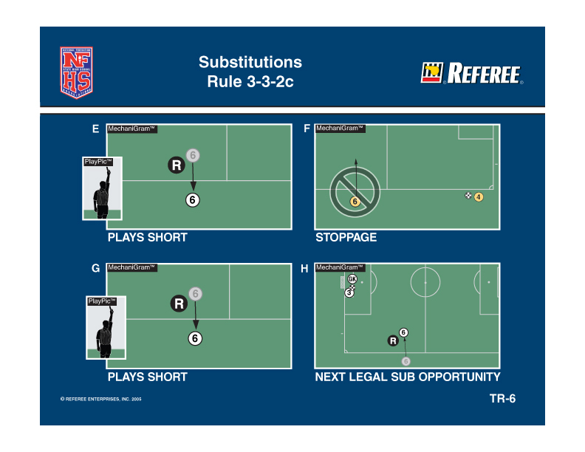
FEDERATION DIFFERENCES
RULE 3 - THE PLAYER & SUBSTITUTIONS
Notes:
Cautioned player

Slide 47
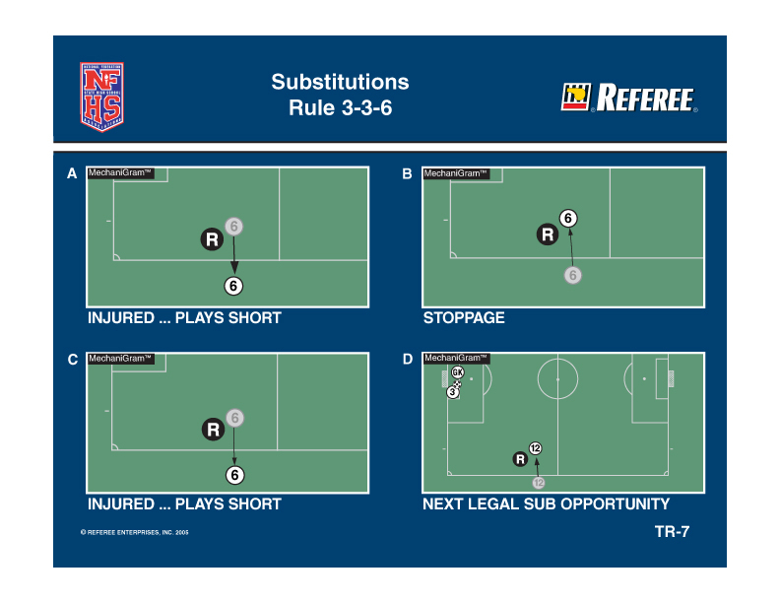
FEDERATION DIFFERENCES
RULE 3 - THE PLAYER & SUBSTITUTIONS
Notes:
Includes the goalkeeper, but goalkeeper must be replaced during time the original goalkeeper is off the field and cannot come back until the next stoppage of play

Slide 48
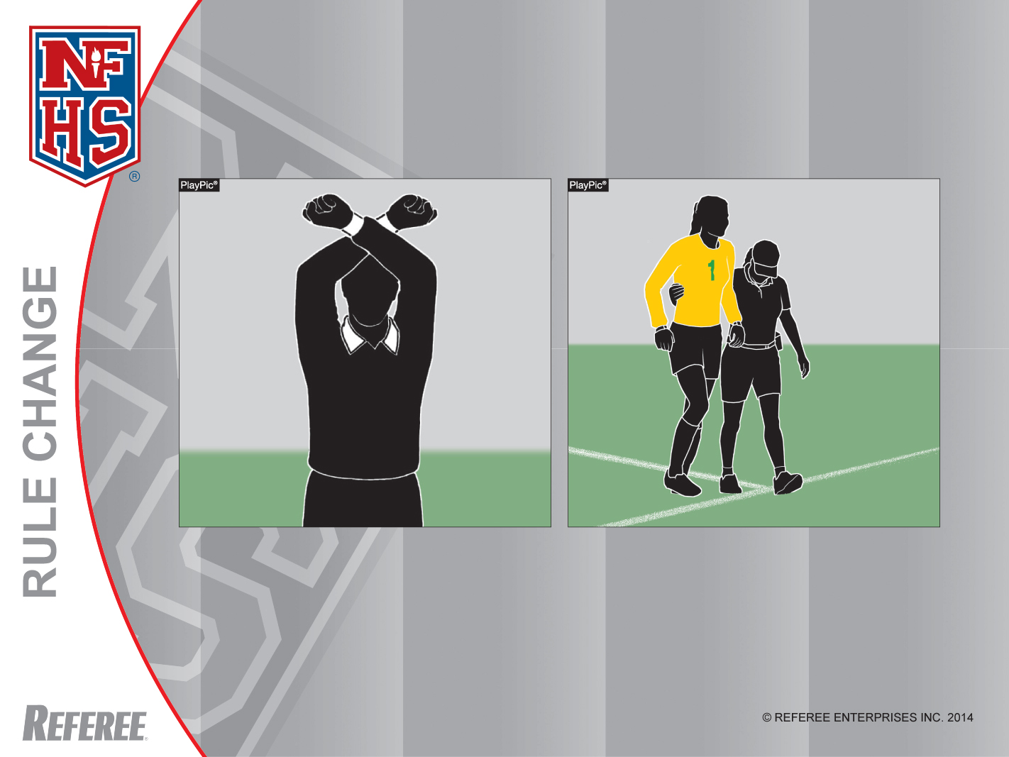
Substitutions
Rule 3-3-2b(2)
If the referee stops the clock for an apparent injury to a field player or goalkeeper, the field player or goalkeeper will have to leave the field. The field player may be replaced and the goalkeeper must be replaced.
Notes:
RULE 3-3-2b(2) – SUBSTITUTIONS
ART. 2 . . . Time for Substitutions: either team may substitute an unlimited number of players from the bench, provided they report to the scorer's table or nearest official and are beckoned in as per 3-4-1(a):
a. when a goal is scored.
b. when a player is injured:
1. A coach or appropriate health-care professional may not enter the field without approval from a referee.
2. If the referee stops the clock for an apparent injury to a field player or goalkeeper, the field player or goalkeeper will have to leave the field. The field player may be replaced, and the goalkeeper shall be replaced.
COMMENTS ON THE RULES
Risk minimization is one of the major tenets of NFHS sports and the rules-writing process. The committee wanted to make sure that players who were apparently injured were evaluated by a coach or an appropriate health-care professional. The overriding concern is the safety of all players. Previously, the goalkeeper was not required to leave the game when the referee stopped the clock.
This new rule requires the field player and goalkeeper to receive equal protection.

Slide 49
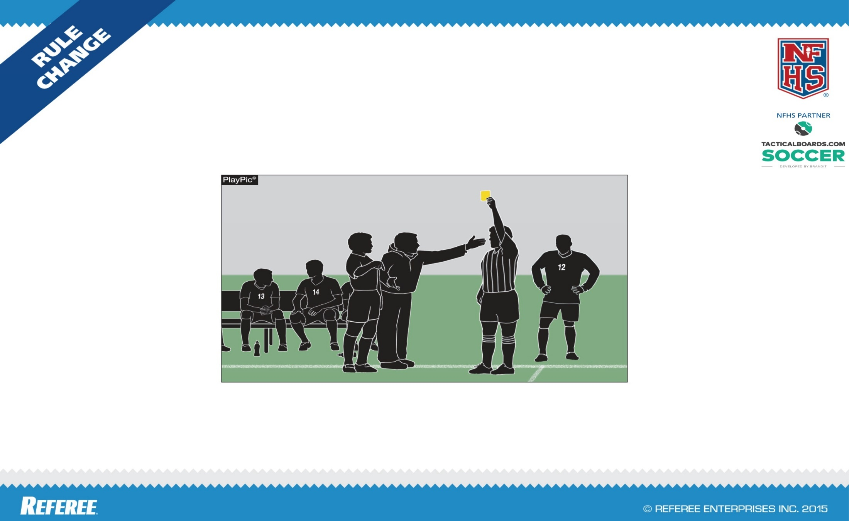
FEDERATION DIFFERENCES
SUBSTITUTION ON BENCH PERSONNEL MISCONDUCT
RULE 3-3-3(e) (new)
If the game is stopped to issue a caution to or to disqualify bench personnel, any player who has already reported to be a substitute can enter the game.

Slide 50
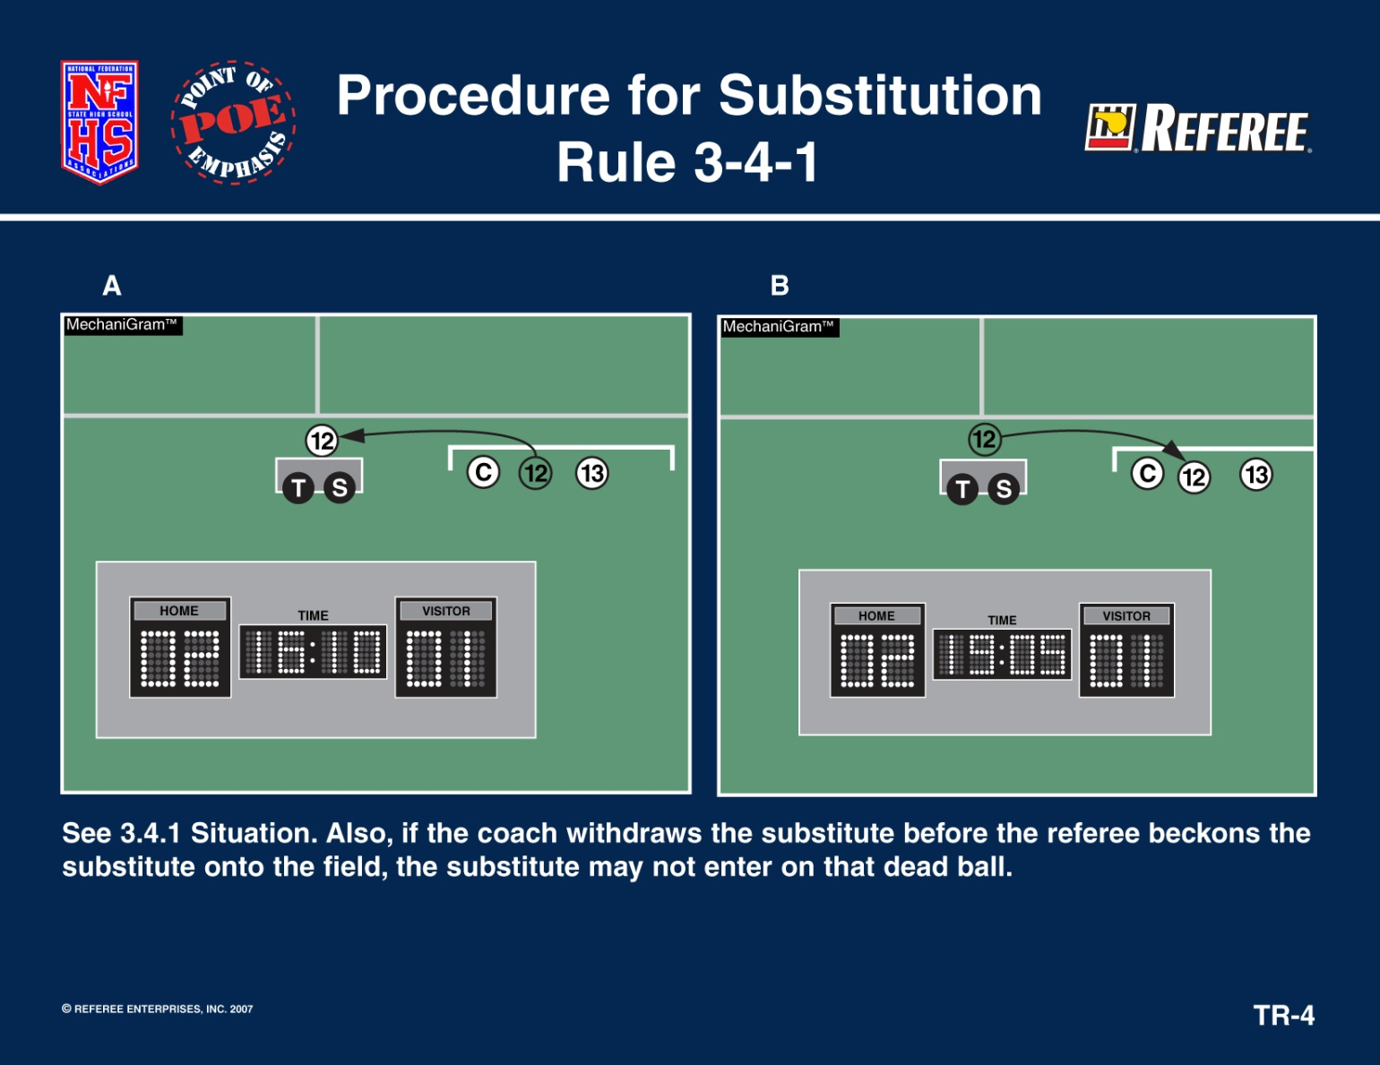
FEDERATION DIFFERENCES
RULE 3 - THE PLAYER & SUBSTITUTIONS

Slide 51
FEDERATION DIFFERENCES
RULE 3 - THE PLAYER & SUBSTITUTIONS
PENALTY KICK – NOT A SUBSTITUTION TIME
  CAUTIONED PLAYER(S)
  INJURED PLAYER(S)
  DISQUALIFIED GOALKEEPER MAY BE SUBSTITUTED FROM THE BENCH, BUT TEAM STILL PLAYS SHORT
  NO SUB MAY TAKE PENALTY KICK
GOALKEEPER/FIELD PLAYER MAY SUBSTITUTE AT NORMAL SUBSTITUTION TIMES OR CLOCK STOPPAGE
IF GOALKEEPER AND PLAYER CHANGE WITHOUT REFEREE’S PERMISSION, IT IS A VERBAL ADMONISHMENT
CAST IF COVERED & FACIAL MASKS WITH A MEDICAL RELEASE ARE ALLOWED
IF A TEAM IS PLAYING SHORT FOR OTHER REASONS THAN MISCONDUCT, THEY MAY ADD ANY LEGAL PLAYER (NOT A SUBSTITUTE) AT ANY STOPPAGE WITH REFEREE’S PERMISSION
Notes:
If a goalkeeper is disqualified on a penalty kick situation, he/she may be substituted from off the bench. New change from NFHS.
During a penalty kick, the substitution situations are only for the cautioned/injured player, not unlimited.

Slide 52
FEDERATION DIFFERENCES
RULE 4 - PLAYER EQUIPMENT
LOGO/TRADE NAME – MAY NOT EXCEED 1 1/2" X 1 1/2" ON EACH ITEM OF APPAREL
AMERICAN FLAG – MAY NOT EXCEED 2” X 3”
SCHOOL LOGOS AND PLAYERS NAMES HAVE NO SIZE RESTRICTED
SOFT & YIELDING CAPS OF THE SAME COLOR ARE LEGAL IN INCLEMENT WEATHER
SHINGUARDS MUST BE NOCSAE APPROVED
  NO PERMANENT LABEL, NO PLAY
  APPROPRIATE HEIGHT RANGE OF PLAYER MUST BE LEGIBLE
  WORN NO HIGHER THAN 2” ABOVE THE ANKLE

Slide 53
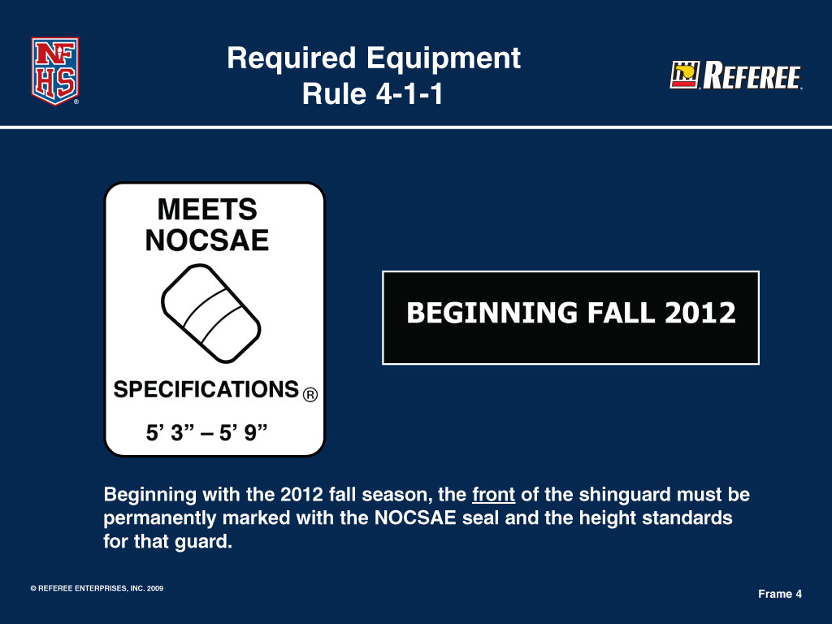
FEDERATION DIFFERENCES
Proper NFHS Shinguards
Notes:
53

Slide 54
FEDERATION DIFFERENCES
Rule 4-1-1A, B
Alters the jersey colors required for teams such that the home team wears dark jerseys and socks and the visiting team wears solid white jerseys and socks.
Notes:
Rule 4-1-1A, B
Alters the jersey colors required for teams such that the home team wears dark jerseys and socks and the visiting team wears all-white jerseys and socks.

Slide 55
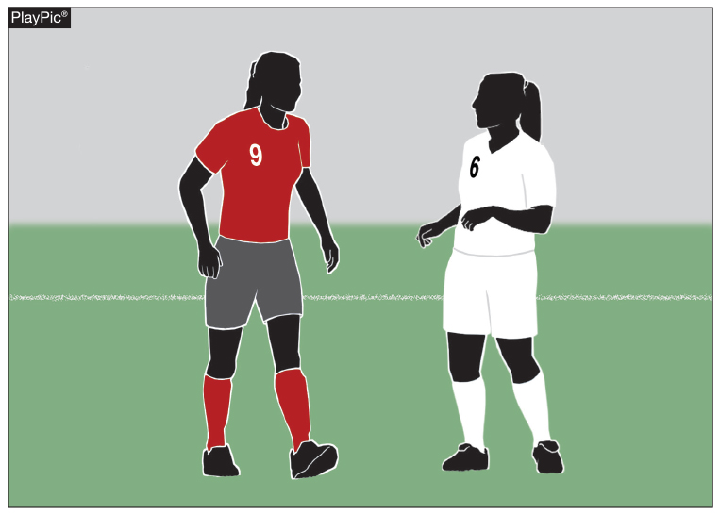
FEDERATION DIFFERENCES
Rule 4-1-1a, b
Required Equipment (Uniform)
Player A is on the Home team and is required to wear the dark colored jersey (clear contrast to white) and dark socks; Player B is a part of the visiting team and is required to wear an all-white jersey and all-white socks.
Notes:
Player A is on the Home team and is required to wear the dark colored jersey (clear contrast to white) and dark socks; Player B is a part of the visiting team and is required to wear an all-white jersey and all-white socks.

Slide 56
FEDERATION DIFFERENCES
RULE 4-1-1D
Allows for visible undergarments to be worn if they are of similar length and of a solid color.
Notes:
Allows for visible undergarments to be worn if they are of similar length and of a solid color.

Slide 57
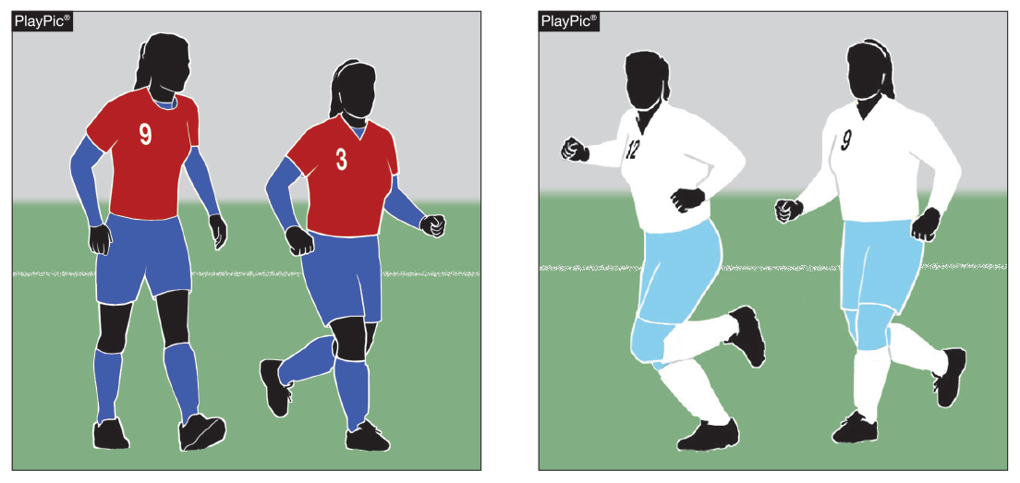
FEDERATION DIFFERENCES
Rule 4-1-1d: Required Equipment (Undergarment)
Any undergarment worn by players must be of a solid like-color for the team members and a similar length for individuals. PlayPic A shows the home team members wearing like-color undergarment. PlayPic B shows the visiting team wearing the all-white jersey and socks with blue shorts and tights.
Notes:
Allows for visible undergarments to be worn if they are of similar length and of a solid color.

Slide 58
FEDERATION DIFFERENCES
RULE 4 - PLAYER EQUIPMENT
REQUIRED EQUIPMENT
  JERSEY DARK = HOME SOLID WHITE = VISITOR
  SHORTS SIMILAR DESIGN & COLOR
  STOCKINGS DARK = HOME SOLID WHITE = VISITOR
  SHOES = SAFE
  NUMBERS 6" REAR OF JERSEY
  4" FRONT OF JERSEY OR PANTS OR SHORTS
ILLEGAL vs. IMPROPER EQUIPMENT - RULE 4 SECTION 2
  CAUTION COACH ON FIRST INCIDENCE OF ILLEGAL EQUIPMENT ON PLAYERS
  CAUTION PLAYER ON ANY INCIDENCES OF ILLEGAL EQUIPMENT FOUND AFTER THE FIRST INCIDENT

Slide 59
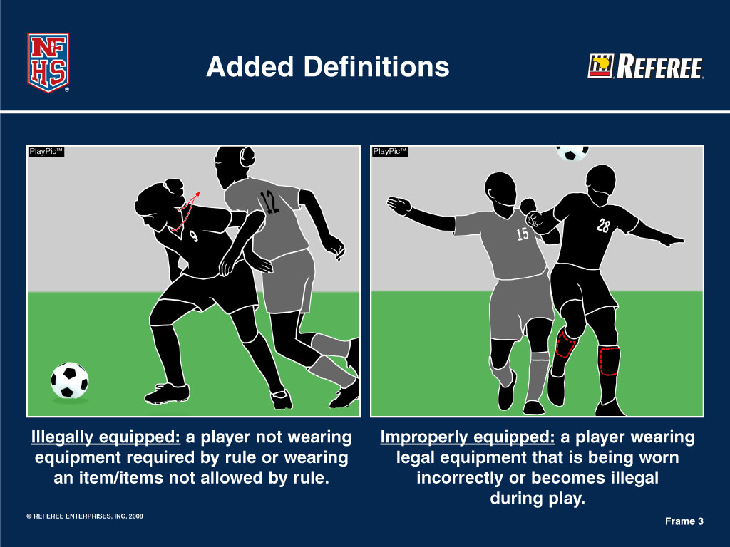
FEDERATION DIFFERENCES
RULE 4 - PLAYER EQUIPMENT (ILLEGAL vs. IMPROPER)

Slide 60
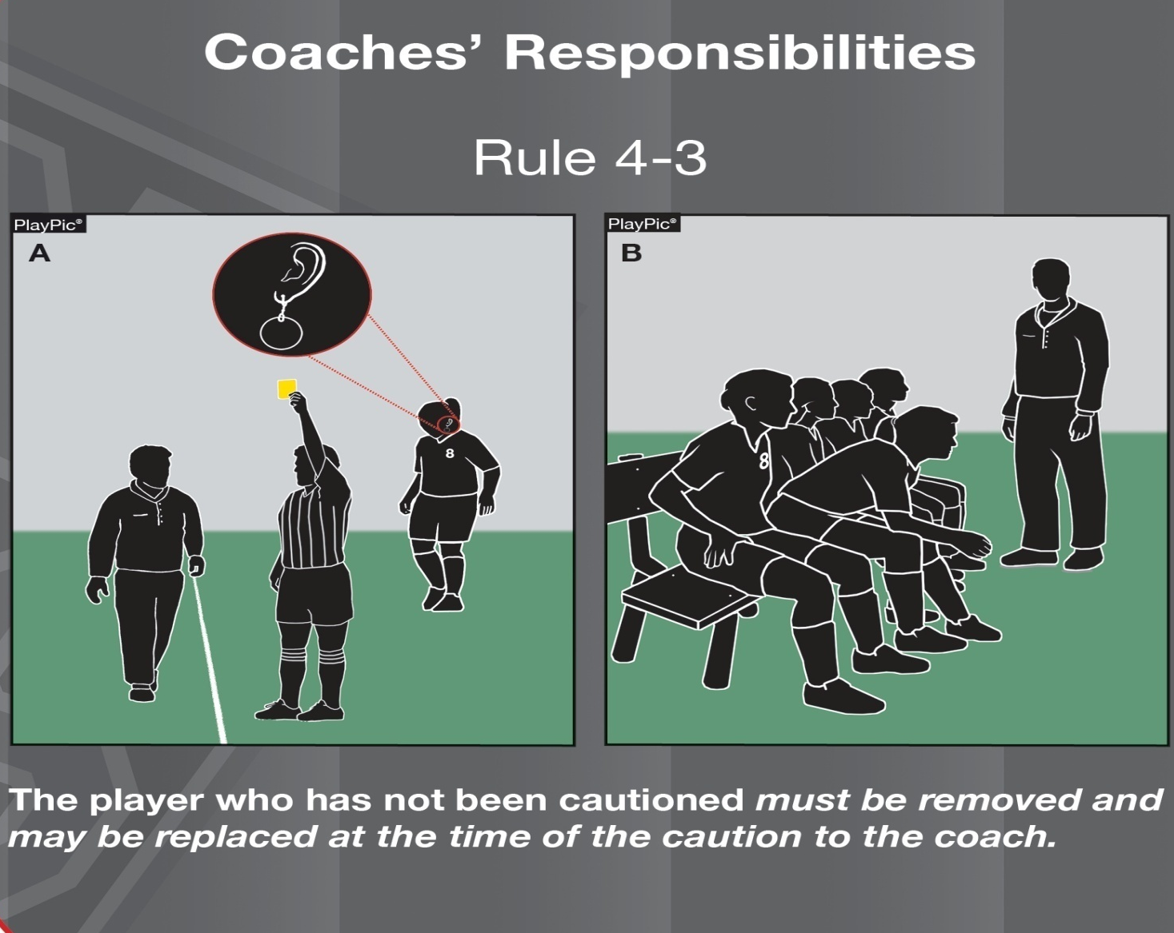
FEDERATION DIFFERENCES
RULE 4 - PLAYER EQUIPMENT

Slide 61
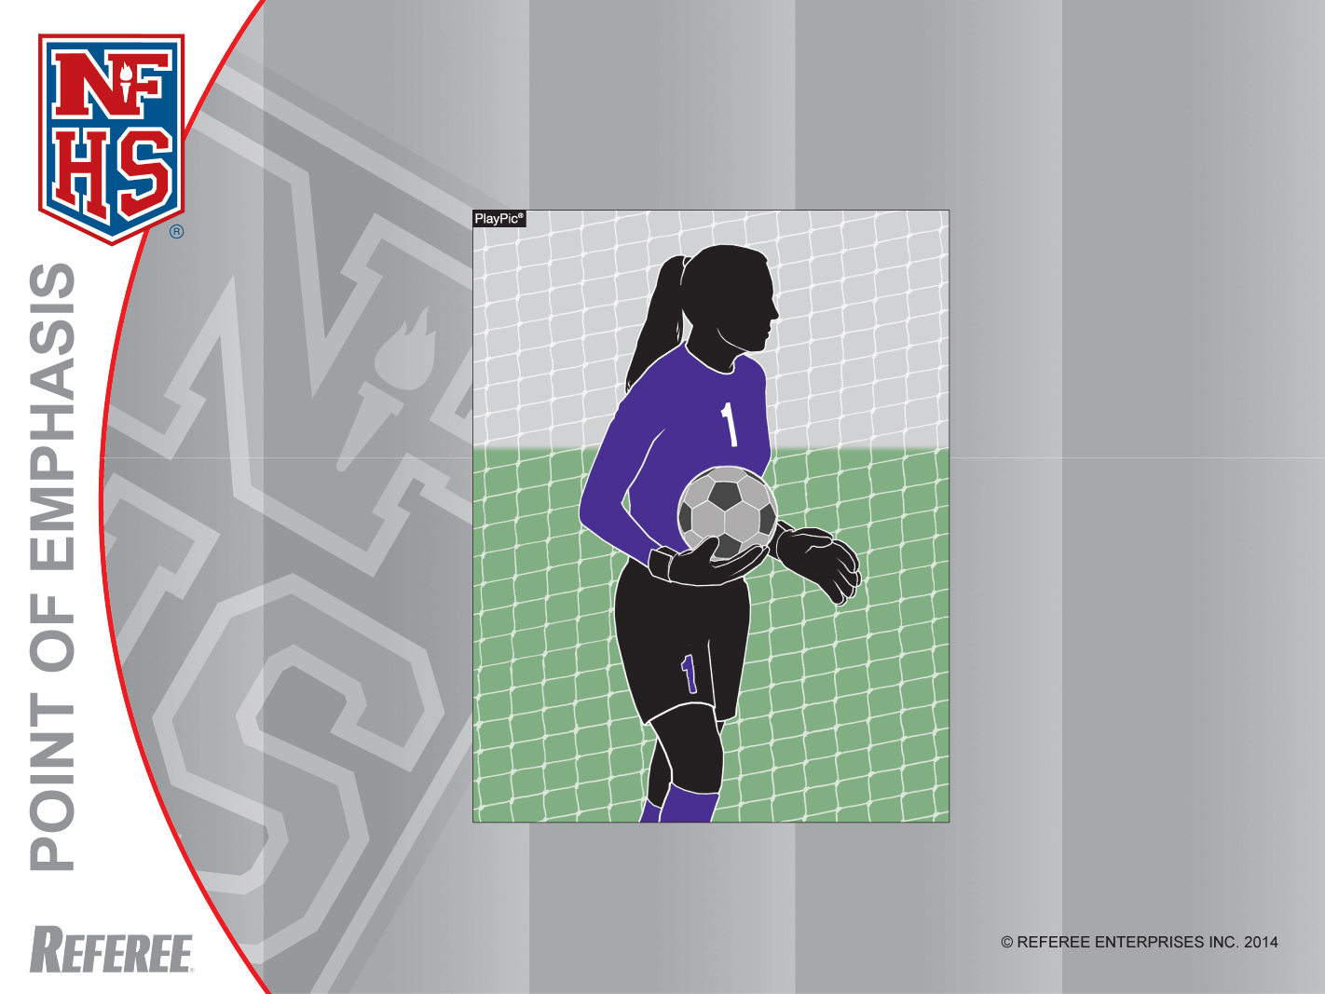
Goalkeepers
Goalkeepers must have a 4” number on the front of their jerseys or shorts/pants and a 6” number on the back of their jerseys.
Notes:
Goalkeepers – Goalkeepers must have a 4” number on the front of their jerseys or shorts/pants and a 6” number on the back of their jerseys.

Slide 62
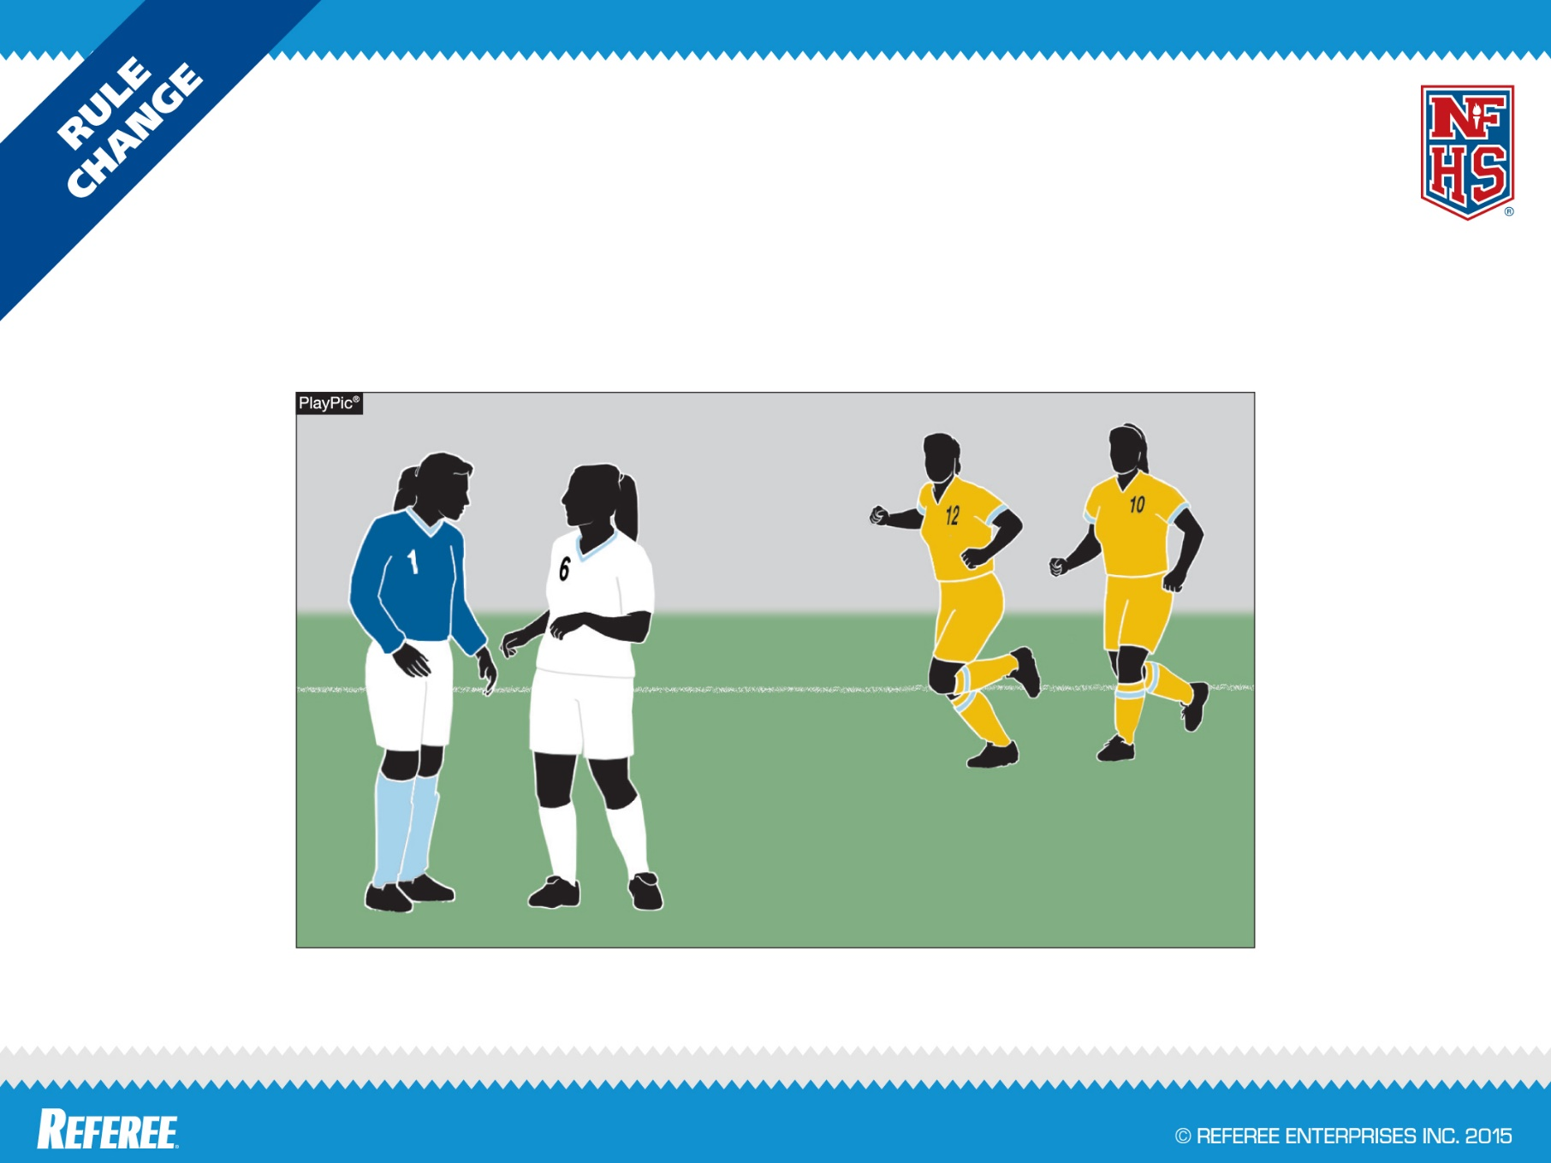
FEDERATION DIFFERENCES
GOALKEEPER SOCKS
DIFFERING FROM OPPONENTS
RULE 4-1-1(h)3
Socks of goalkeeper must differ from opponents.

Slide 63
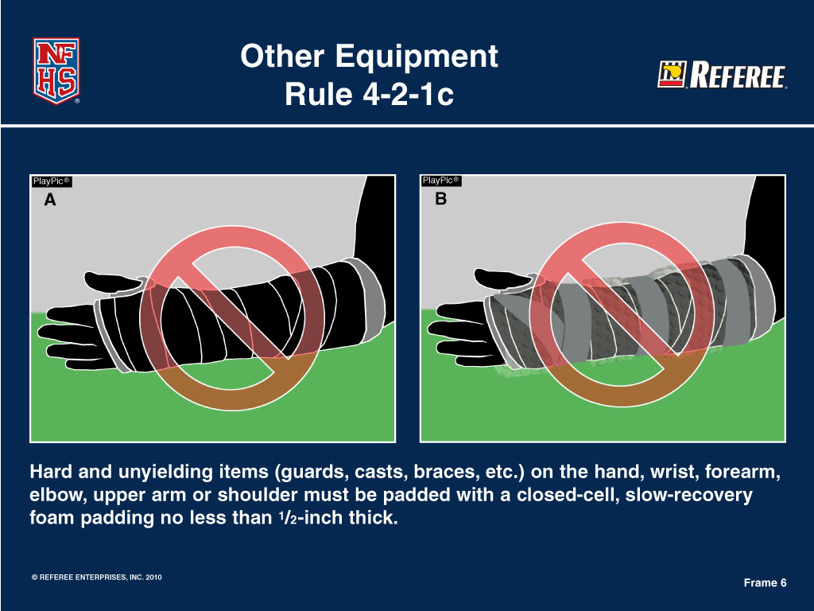
FEDERATION DIFFERENCES
RULE 4 - PLAYER EQUIPMENT

Slide 64
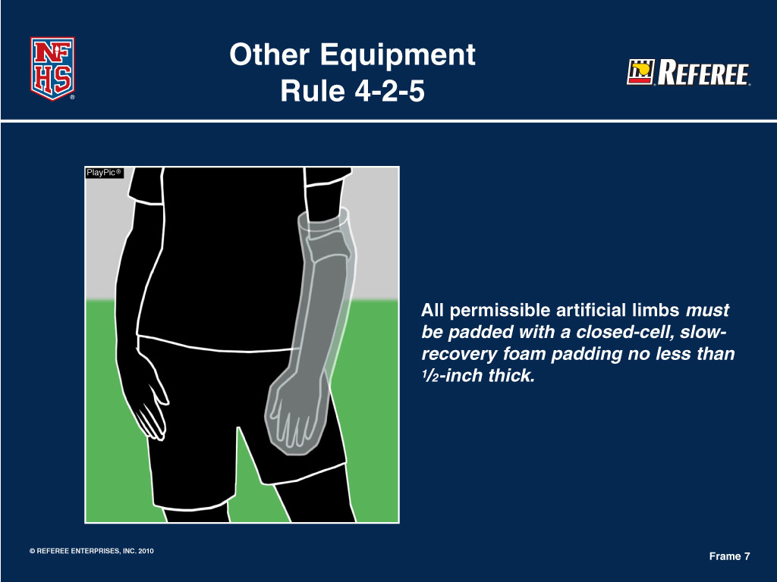
FEDERATION DIFFERENCES
RULE 4 - PLAYER EQUIPMENT

Slide 65
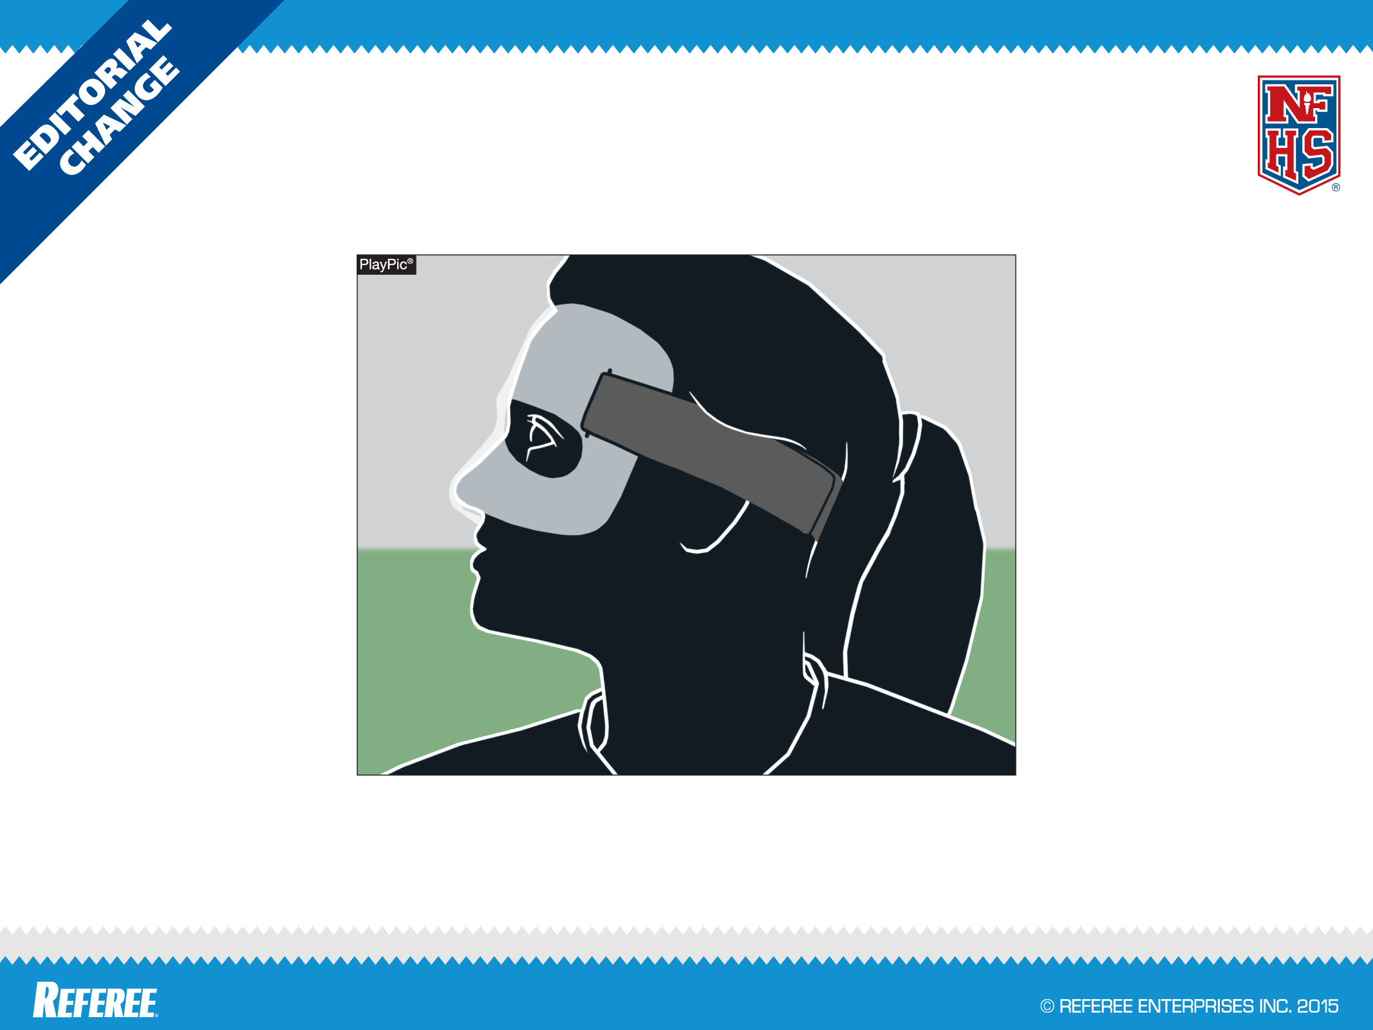
FEDERATION DIFFERENCES
PROTECTIVE FACE MASK
RULE 4-2-8
Removing “with no protrusion” from the rule clears the issue of the nose as a protrusion.

Slide 66
FEDERATION DIFFERENCES
RULE 4-2-9
A soft padded headgear
A soft padded headgear that meets the ASTM standard is permitted.
No headgear can stop athletes form suffering concussions, and all sports should be played, coached and officiated in recognition of that fact.
Notes:
RULE 4-2-9 A SOFT PADDED HEADGEAR
A soft padded headgear that meets the ASTM standard is permitted.
No headgear can stop athletes form suffering concussions, and all sports should be played, coached and officiated in recognition of that fact.
This rule change allows for the use of the newer headgear styles that are currently on the market to be used that are not just headbands.

Slide 67
FEDERATION DIFFERENCES
Rule 4-2-9
Other Equipment
The ability to wear headgear has been expanded beyond headbands. PlayPic A remains legal and the change now makes PlayPic B legal. Wearing of any headgear is not required. Schools, parents and students are encouraged to make their own assessment on the type of equipment worn via ASTM standards.
Notes:
RULE 4-2-9 – OTHER EQUIPMENT
The ability to wear headgear has been expanded beyond headbands. PlayPic A remains legal and the change now makes PlayPic B legal. Wearing of any headgear is not required. Schools, parents and students are encouraged to make their own assessment on the type of equipment worn via ASTM standards.
No headgear can stop athletes from suffering concussions, and all sports should be played, coached and officiated in recognition of this fact.

Slide 68
RULE 4-2-10 (NEW)
FEDERATION DIFFERENCES
Allows for state associations (or delegate) to permit the wearing of head coverings or wraps if criteria is met for medical/cosmetic and/or religious reasons.
Notes:
RULE 4-2-10 (NEW)
Allows for state associations (or delegate) to permit the wearing of head coverings or wraps if criteria is met for medical/cosmetic and/or religious reasons.

Slide 69
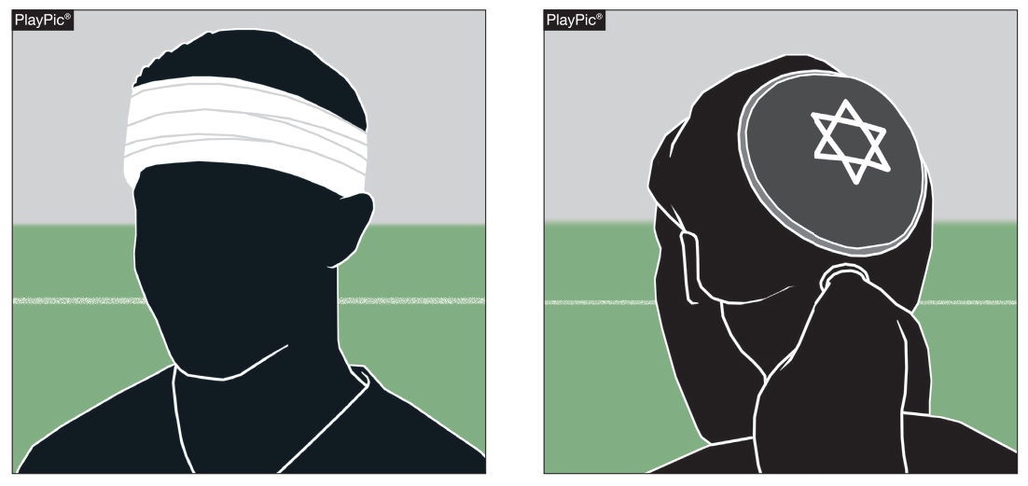
4-2-10: Other Equipment
FEDERATION DIFFERENCES
In PlayPic A and B, both items would be legal. In both A and B, wearing a head covering will require appropriate documentation showing state association approval to be allowed.
Notes:
4-2-10: Other Equipment
In PlayPic A and B, both items would be legal. In both A and B, wearing a head covering will require appropriate documentation showing state association approval to be allowed.

Slide 70
FEDERATION DIFFERENCES
RULE 5 - THE OFFICIALS
OFFICIALS
  HEAD REFEREE
  REFEREE OR ASSISTANT REFEREE
  SHALL CHANGE TO DIFFERENT JERSEY (GOLD OR BLACK)
PREGAME
  HEAD REFEREE
    MEET WITH GAME ADMINISTRATOR
    INSPECT AND APPROVE GAME BALLS, FIELD, ETC.
    CONDUCT AN INFORMAL INSPECTION OF THE PLAYERS
    REVIEW SPECIFIC DUTIES SCORER, TIMER, ASSISTANT REFEREES
    CONDUCT A PRE-GAME CONFERENCE WITH CAPTAINS AND HEAD COACH
Notes:
The “Sportsmanship Statement” should be given to both coaches and captains sometime during the pregame.

Slide 71
FEDERATION DIFFERENCES
RULE 5 - THE OFFICIALS
PREGAME (CONTINUED)
  REFEREE OR ASSISTANT REFEREES
    ASSIST HEAD REFEREE
    REVIEW DUTIES WITH BALL HOLDERS
    ASSIST WITH PRE-GAME CONFERENCE
DURING GAME
  BOTH OFFICIALS
    WHEN SIGNALING, USE OFFICIAL NFHS SOCCER SIGNALS
    JURISDICTION ENDS......
  HEAD REFEREE
    DECIDES IF 2 DISAGREE (GOAL ONLY)
AFTER THE GAME
  HEAD REFEREE
    VERIFIES THE SCORE
    REPORTS, IN WRITING, ALL DISQUALIFICATIONS (CAUTIONS ALSO FOR GISA)

Slide 72
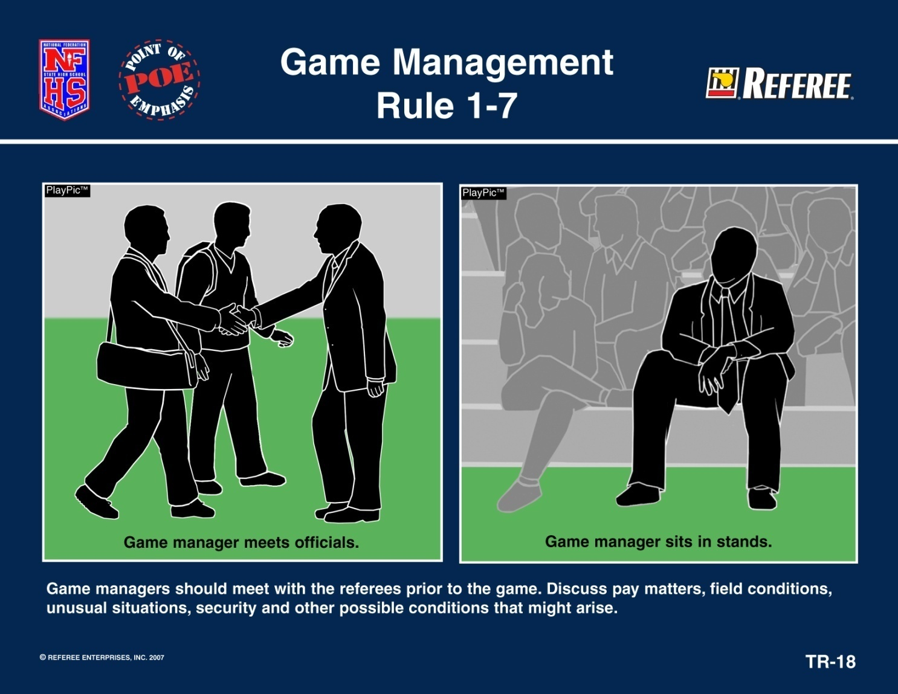
FEDERATION DIFFERENCES
RULE 5 - THE OFFICIALS (PRE-GAME CONFERENCE)
Notes:
The “Sportsmanship Statement” should be given to both coaches and captains sometime during the pregame.

Slide 73
FEDERATION DIFFERENCES
RULE 5 - THE OFFICIALS (PRE-GAME CONFERENCE)
ARE YOUR PLAYERS PROPERLY AND LEGALLY EQUIPPED?
REMIND THE HEAD COACHES AND CAPTAINS THAT NFHS & GHSA EMPHASIZES GOOD SPORTSMANSHIP
CONDUCT A COIN-TOSS 5 MINUTES BEFORE START OF PLAY
Notes:
The “Sportsmanship Statement” should be given to both coaches and captains sometime during the pregame.

Slide 74
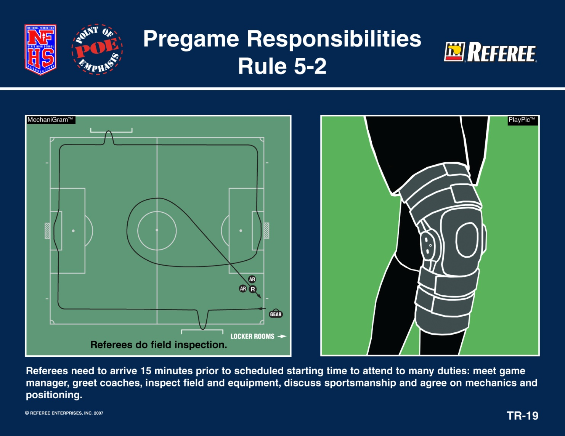
FEDERATION DIFFERENCES
RULE 5 - THE OFFICIALS

Slide 75
Team Member Equipment Check
FEDERATION DIFFERENCES
Because of the number of recent rule changes involving uniforms and equipment, officials are encouraged to informally check the equipment of team members before the game to prevent possible player-equipment violations.
Notes:
Team Member Equipment Check
Because of the number of recent rules changes involving uniforms and equipment, officials are encouraged to informally check the equipment of team members before the game to prevent possible player equipment violations occurring during the game.

Slide 76
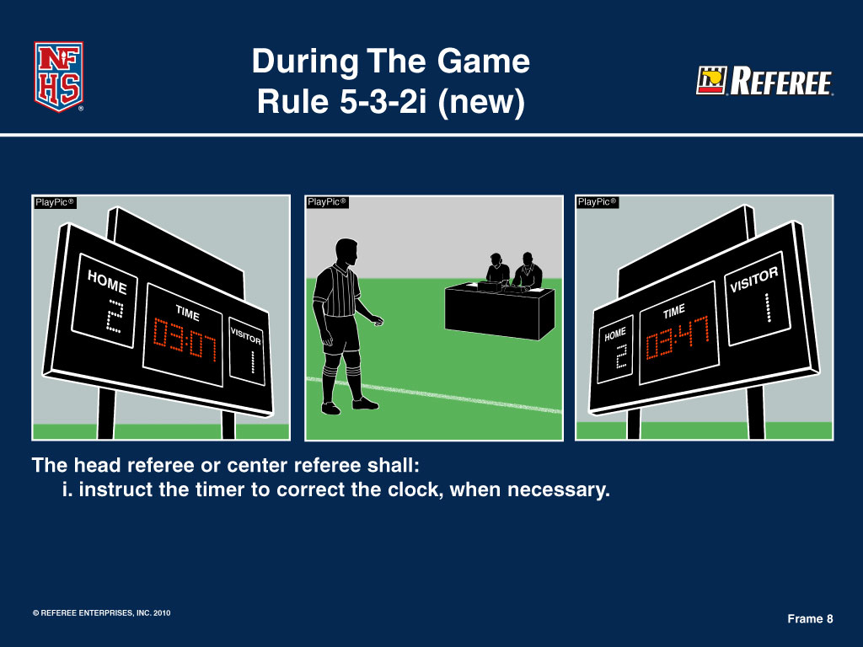
FEDERATION DIFFERENCES
RULE 5 - THE OFFICIALS

Slide 77
FEDERATION DIFFERENCES
RULE 5 - THE OFFICIALS (SPORTSMANSHIP STATEMENT)
“The GHSA and its member schools have made a commitment to promote good sportsmanship by student/athletes, coaches, and spectators at all GHSA sanctioned events. Profanity, degrading remarks, and intimidating actions directed at officials, competitors, or other spectators will not be tolerated, and are grounds for removal from the event site. Spectators are not allowed to enter the competition area during warm-ups or while the contest is being conducted. Thank you for your cooperation in the promotion of good sportsmanship at today’s event.”
Notes:
The “Sportsmanship Statement” should be given to both coaches and captains sometime during the pregame.

Slide 78
FEDERATION DIFFERENCES
GHSA White Book Guidance and Direction for Referees
Teams arriving late for a contest by thirty (30) minutes or more shall forfeit the match, and shall pay the officials unless prior arrangements are made in a timely manner, and both teams agree to start the game late or reschedule it.
Consideration will also be given to emergency situations over which the traveling school has no control.
The host school has the responsibility of notifying the officials of these changes.

Slide 79
FEDERATION DIFFERENCES
GHSA White Book Guidance and Direction for Referees
The “Host School” must provide a private and secure area for the game officials to meet prior and following the contest.
The “Host School” is responsible to have visible security on site prior to , during, and following each contest until the time the contest officials exited the property.

Slide 80
FEDERATION DIFFERENCES
GHSA White Book Guidance and Direction for Referees
The Contest Officials Handbook and Accountability Program is located on the GHSA website under Officials at http://www.ghsa.net/officials-uniforms
SOCCER
Handle by local associations
Notes:
On the GHSA website under “Officials” there is a link to the revised handbook. I only listed the soccer uniform requirements.

Slide 81
FEDERATION DIFFERENCES
RULE 5 - THE OFFICIALS
THESE ARE THE OFFICIAL SIGNALS TO BE USED IN ALL HIGH SCHOOL GAMES
  IN A DUAL SYSTEM GAME, THIS IMPROVES COMMUNICATION BETWEEN OFFICIALS, COACHES, AND THE FANS
  IN A THREE-MAN SYSTEM, THE CENTER IS TO USE THESE SIGNALS
    THE ASSISTANT REFEREES COULD USE THESE SIGNALS TO DISCRETELY COMMUNICATE INFORMATION TO THE CENTER REFEREE

Slide 82

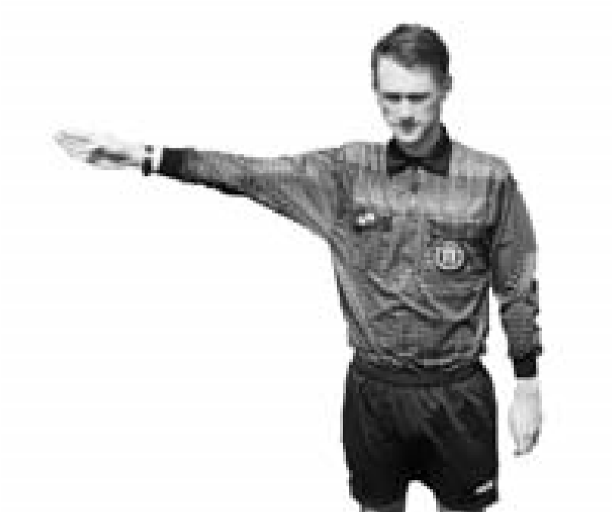
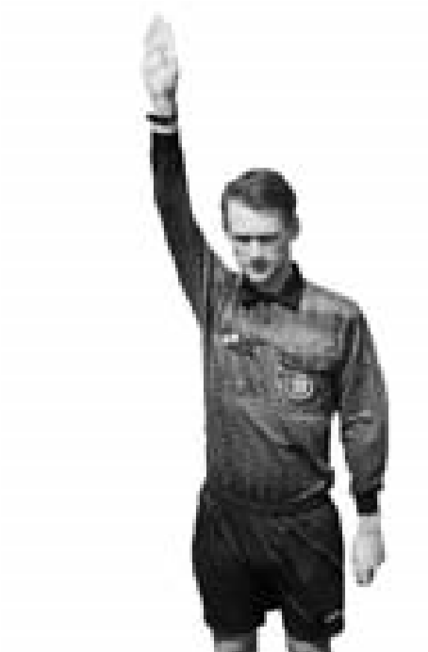
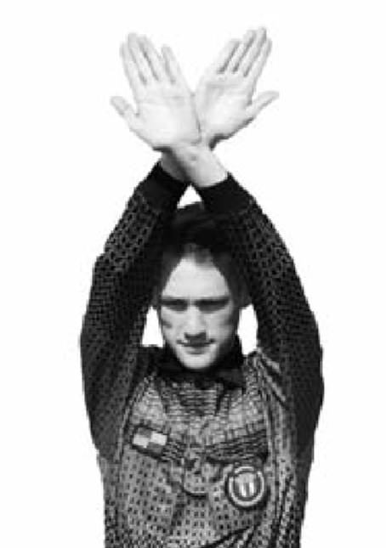
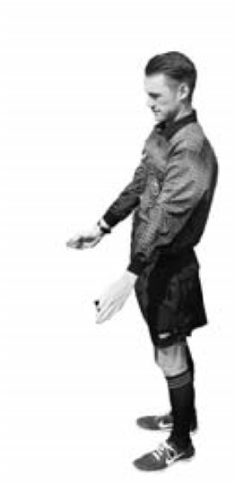
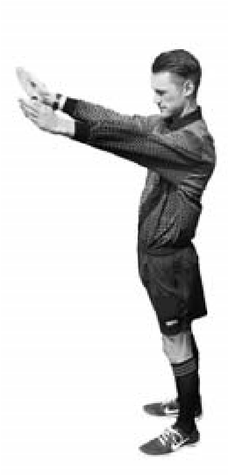
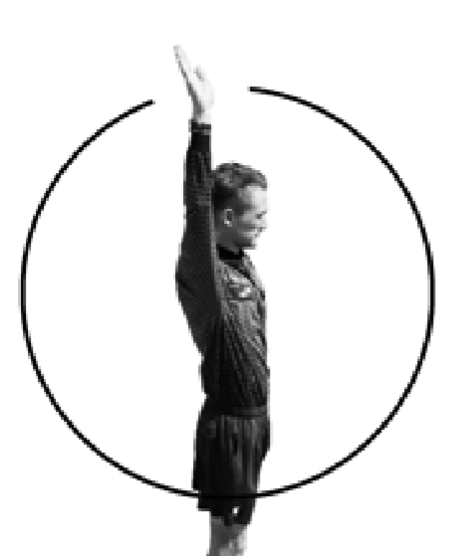
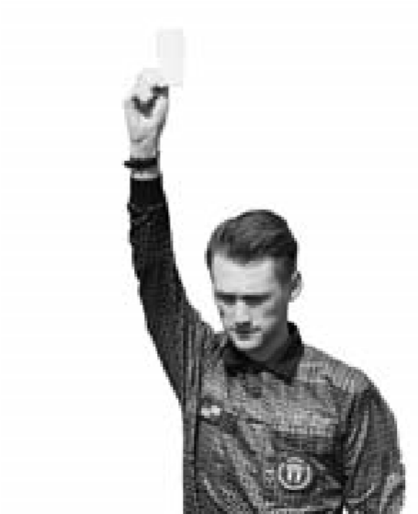
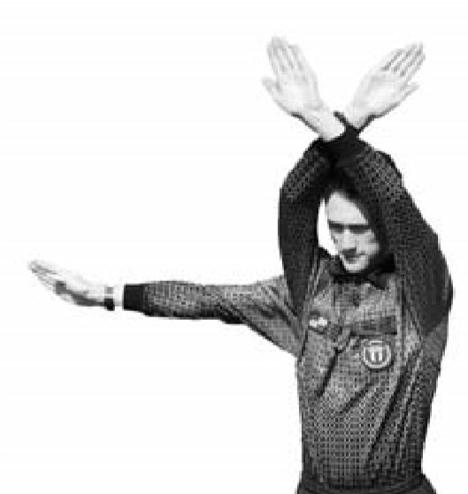
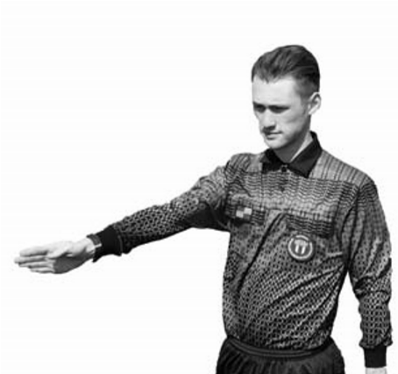
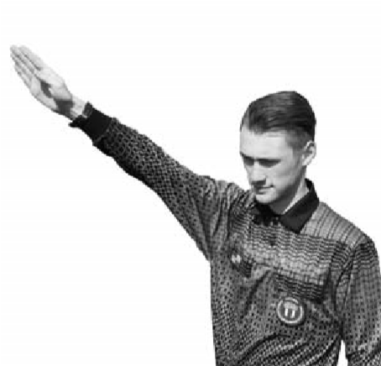
NFHS Official Soccer Signals
1
2
3-1
3-2
4
Direct free kick
Indirect
(
points in direction of kick
Play On
Timeout
)
free kick
5
6
7
8
9
1
➤
➤
2
NFHS Official Soccer Signals
➤
➤
Penalty Kick
(
point to spot),
Corner Kick
(
Wind-up to start
Goal Kick
Caution/
(
point to corner
(
point to goal area
)
Goal
clock)
)
ejection

Slide 83
NFHS Official Soccer Signals
Throw In
Substitution
Foul
Corner Kick
Goal Kick
Stop Play Offside
Offside
Far side
Offside
Middle
Offside
Near side

Slide 84
FEDERATION DIFFERENCES
RULE 6 - BALL HOLDERS, TIMER, AND SCORER
HOME TEAM PROVIDES
  2 BALL HOLDERS
  OFFICIAL TIMER
    SIGNALS FOR SUBSTITUTIONS
  OFFICIAL SCORER
    COMPLETE LINEUP
    LINEUP MAY BE MODIFIED AFTER START OF MATCH

Slide 85
FEDERATION DIFFERENCES
RULE 7 - DURATION OF THE GAME AND LENGTH OF PERIODS
2 EQUAL HALVES (IN GEORGIA)
  VARSITY 40 MINUTES
  9TH & JV 35 MINUTES
  7TH & 8TH 30 MINUTES
FEDERATION SAYS YOU MAY PLAY QUARTERS
TO SHORTEN MATCH
  STATE ASSOCIATION
  AGREEMENT OF COACHES
  ORDERED BY HEAD REFEREE
DETERMINE BEFORE GAME OR 2ND HALF BEGINS
SUSPENDED GAME CONSIDERED COMPLETE IF 1st HALF HAS BEEN PLAYED ON GAMES THAT ARE NOT OF THE SAME CLASSIFICATION

Slide 86
FEDERATION DIFFERENCES
RULE 7 - DURATION OF THE GAME AND LENGTH OF PERIODS
HALFTIME 10 MINUTES UNLESS COACHES DECIDE
  PLAYER(S) DISQUALIFIED, DURING HALFTIME, DOES NOT EFFECT TEAMS’ ON-FIELD NUMBERS
  5 MINUTES BETWEEN REGULATION AND FIRST OVER-TIME PERIOD
  2 MINUTES BETWEEN OVER-TIME PERIODS
TIE GAME (DIFFERENT CLASSIFICATIONS)
  NO OVERTIME INVOKED WHEN REGULATION PLAY ENDS WITH A TIE SCORE,
  UNLESS BOTH COACHES AGREE AND INFORM THE MATCH OFFICIALS PRIOR TO THE START OF PLAY
TIE GAME (SAME CLASSIFICATION & PLAY OFFS ONLY!)
  THE OVERTIME WILL CONSIST OF ONE (1) FIFTEEN-MINUTE PERIOD
  A COIN TOSS SHALL TAKE PLACE TO DETERMINE WHICH TEAM WILL PUT THE BALL IN PLAY FOR THE OVERTIME PERIOD.
  IF THE SCORE REMAINS TIED FOLLOWING THE OVERTIME PERIOD, A “SHOOTOUT” OF PENALTY KICKS WILL DETERMINE THE WINNER.
  THE PENALTY KICKS PROCEDURE WILL BE COVERED UNDER RULE 14
Notes:
Note: Only one fifteen minute overtime period!!!

Slide 87
FEDERATION DIFFERENCES
GHSA WHITEBOOK RULES
Games involving schools from different classifications:
  Up to two-hour cumulative delay may be used to complete the contest
  Contest cannot go past GHSA 11:30 p.m. curfew
  If the contest is terminated prior to the end of the 1st half, “no contest” is declared
  If the contest is terminated after the 1st half is completed, the score at that point is final
Games involving schools from the same classification:
  The two-hour time delay does not exist
  The 11:30 p.m. GHSA curfew is waived (NOT the local government curfew)
  School administrators may agree to terminate the game and resume play at the point of interruption
  The trailing team may choose not to resume play at a later date

Slide 88
FEDERATION DIFFERENCES
RULE 7 - DURATION OF THE GAME AND LENGTH OF PERIODS
POINT DIFFERENCE MAY TERMINATE
  THE MINUTES SHOWN ARE REPRESENTATIVE OF A VARSITY MATCH
    SUB-VARSITY IS HALF OF THE DURATION OF THEIR HALF
  IF A TEAM IS 7 OR MORE GOALS DOWN AT THE MIDPOINT OF THE FIRST HALF, THE HALF WILL END AND THE SECOND HALF WILL BE 20 MINUTES IN LENGTH
  IF A TEAM IS 7 OR MORE GOALS DOWN AT HALFTIME, THE SECOND HALF WILL BE 20 MINUTES IN LENGTH
  WHEN A TEAM TRAILS BY TEN (10) OR MORE GOALS DOWN AT HALFTIME, THE GAME WILL BE TERMINATED

Slide 89
FEDERATION DIFFERENCES
RULE 7 - DURATION OF THE GAME AND LENGTH OF PERIODS
STOP THE CLOCK FOR THE FOLLOWING:
  PENALTY KICK
  ISSUING CARDS
  AFTER A GOAL
  ANYTIME THE REFEREE SAYS
    INJURY
    DELAY OF GAME
    OTHER ???

Slide 90
FEDERATION DIFFERENCES
RULE 8 - THE START OF PLAY
START OF PLAY
  FIFA
    SIGNAL FROM REFEREE
    BALL MAY MOVE IN ANY DIRECTION TO BE INPLAY
  HIGH SCHOOL
    REFEREE SIGNALS WITH WHISTLE
    BALL MAY MOVE IN ANY DIRECTION TO BE INPLAY
    CANNOT SCORE DIRECTLY IN YOUR OWN GOAL
COIN TOSS
  FIFA - WINNER CHOOSES END TO ATTACK
  HIGH SCHOOL – WINNER CHOOSES EITHER BALL OR GOAL TO ATTACK

Slide 91
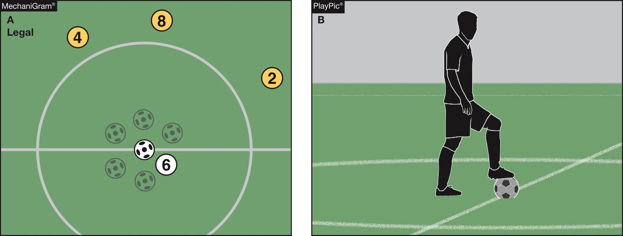
FEDERATION DIFFERENCES
Rule 8-1-3
Kickoff
The ball is in play when it is kicked and clearly moves in any direction (MechaniGram A). The ball is not in play until it has clearly moved (PlayPic B).
Notes:
RULE 8-1-3 - KICKOFF
The ball is in play when it is kicked and clearly moves in any direction (MechaniGram A). The ball is not in play until it has clearly moved (PlayPic B).

Slide 92
FEDERATION DIFFERENCES
RULE 9 - BALL IN AND OUT OF PLAY
REFEREE SOUNDS HIS WHISTLE
  OUT OF BOUNDS… IF NEEDED
  FOULS
  FOR CERTAIN RESTARTS
    PENALTY KICK
    AFTER SUBSTITUTION
    AFTER CAUTIONS
    AFTER DISQUALIFICATIONS
    AFTER INJURY TIMEOUT
    AFTER ENCROACHMENT
    WHEN NEEDED TO END CONFUSION
TEMPORARY SUSPENSIONS
  CLEAR POSSESSION IFK FROM PLACE OF BALL
  OTHERWISE A DROP BALL

Slide 93
FEDERATION DIFFERENCES
RULE 9 - BALL IN AND OUT OF PLAY
DROP BALL PROCEDURES
  WHEN THE FOLLOWING OCCURS:
    OUT OF BOUNDS BY 2 OPPONENTS
    BALL DEFLATED
    UNUSUAL SITUATION INJURY, DOG, ETC.
    SIMULTANEOUS FOULS OF SAME DEGREE
  CONDITIONS
    NOT IN GOAL AREA
    5 YARDS FROM BOUNDARY
    BETWEEN 2 OPPOSING PLAYERS
    CAN SCORE DIRECTLY FROM A DROP BALL
    2ND VIOLATION - MAY RESULT IN A CAUTION

Slide 94
FEDERATION DIFFERENCES
RULE 10 - SCORING
RULE 10 – NO DIFFERENCES
FORFEITS (HANDLED BY GHSA)
  IF NOT STARTED 1-0
  IF TEAM AHEAD 1-0
  IF TEAM BEHIND SCORE OF GAME
WITH ALL FORFEITS, A REPORT MUST BE SUBMITTED TO GHSA THROUGH YOUR ASSOCIATION

Slide 95
FEDERATION DIFFERENCES
RULE 11 - OFFSIDE
NO DIFFERENCES
BUT….
Notes:
The new definition of gaining advantage by being in that position and receiving the ball from a deliberate play and not a deliberate save….

Slide 96
FEDERATION DIFFERENCES
Offside Restarts:
Location of Offside Restart
Position A
Position B
The restart for offside infractions is an indirect free kicks taken from the spot where the offending player interfered with play, interfered with an opponent or gained advantage by being in that position.
Notes:
RESTARTS: LOCATION OF OFFSIDE RESTART
The restart for offside infractions is an indirect free kicks taken from the spot where the offending player interfered with play, interfered with an opponent or gained advantage by being in that position.

Slide 97
FEDERATION DIFFERENCES
RULE 12 - FOULS AND MISCONDUCT
HIGH SCHOOL A PLAYER SHALL NOT
FIFA CARELESS, RECKLESS, EXCESSIVE FORCE
DEFINES FAIR CHARGE
VERY PROTECTIVE OF THE GOALKEEPER
  IN POSSESSION 12.4.3
  DISQUALIFICATION-FLAGRANTLY 12.4.2A
OBSTRUCTION
DANGEROUS PLAY
  - HIGH SCHOOL SELF, TEAMMATE, OR OPPONENT
  - FIFA SELF & OPPONENT

Slide 98
FEDERATION DIFFERENCES
RULE 12 - FOULS AND MISCONDUCT
DOGSO – SAME AS FIFA
GOALKEEPER
  CANNOT CHARGE GOALKEEPER UNLESS:
    HE IS OBSTRUCTING
    HE IS PLAYING AS FIELD PLAYER
NOTIFICATION OF ALL CARDS MUST BE GIVEN TO EACH COACH
TAUNTING - RED CARD OFFENSE

Slide 99
FEDERATION DIFFERENCES
RULE 12 - FOULS AND MISCONDUCT
MISCONDUCT - PLAYERS, COACH, TEAM OFFICIALS
  SIT OUT 1 OR 2 GAME(S)
  DISQUALIFIED COACH......LEAVE THE AREA OF THE GAME
  DISQUALIFIED PLAYER...…LEAVE THE FIELD OF PLAY (ONLY SENT AWAY, IF WITH ADULT SUPERVISION)
  DISQUALIFIED TRAINER….IF ONLY ONE THERE, NEAR ENOUGH TO BE CALLED BACK FOR TREATMENT OF INJURIES
U.S.L.C. FOR THE BENCH IFK
  IF YOU DON’T KNOW WHO DID IT THEIR COACH GETS THE CARD

Slide 100
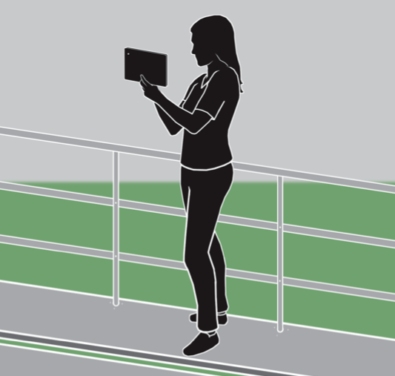
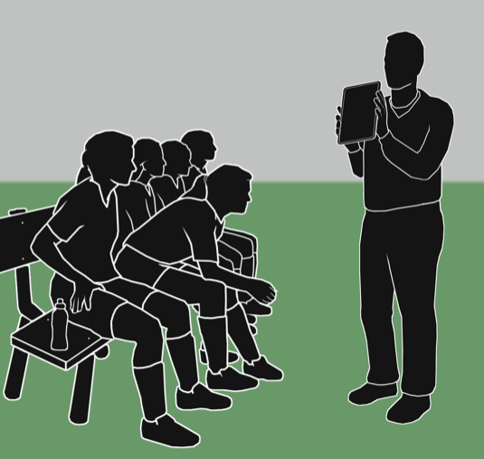
FEDERATION DIFFERENCES
RULE 12 - FOULS AND MISCONDUCT
While use of electronic communication devices with on-field players during play is still prohibited, the use of electronic devices on the sideline is allowed.

Slide 101
FEDERATION DIFFERENCES
RULE 13 - FREE KICK
DESCRIBES WHEN TO AWARD ALL FREE KICKS

Slide 102
Rule 13-2-1j (new)
FEDERATION DIFFERENCES
Provides for a penalty for a player(s), coach or bench personnel who enters or leaves the field without permission from an official and interferes with play or an official.
Notes:
Rule 13-2-1j (new)
Provides for a penalty for a player(s), coach or bench personnel who enters or leaves the field without permission from an official and interferes with play or an official.

Slide 103
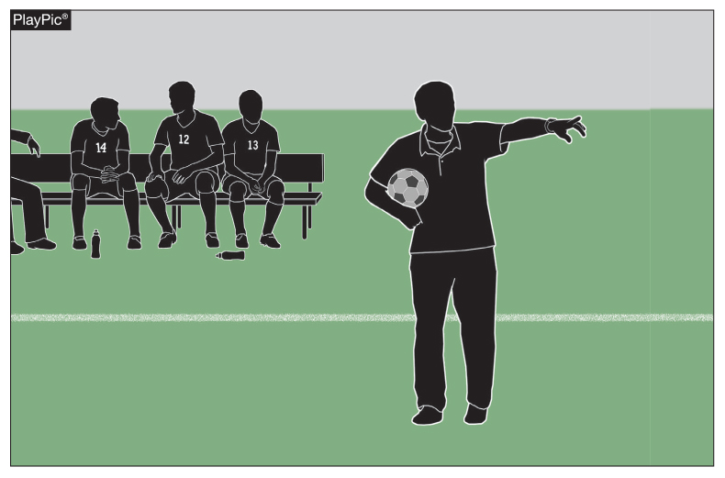
13-2-1j: Free Kick: When Awarded
FEDERATION DIFFERENCES
A player, coach or bench personnel enters or leaves the playing field without permission from the official and interferes with play or an official shall be penalized with a direct free kick from the point of the infraction.
Notes:
13-2-1j: Free Kick: When Awarded
A player, coach or bench personnel enters or leaves the playing field without permission from the official and interferes with play or an official shall be penalized with a direct free kick from the point of the infraction.

Slide 104
Rule 13-2-3
FEDERATION DIFFERENCES
Provides for a penalty for a player(s), coach or bench personnel who enters or leaves the field without permission from the official and does not interfere with play or the official.
Notes:
Rule 13-2-3
Provides for a penalty for a player(s), coach or bench personnel who enters or leaves the field without permission from the official and does not interfere with play or the official.

Slide 105
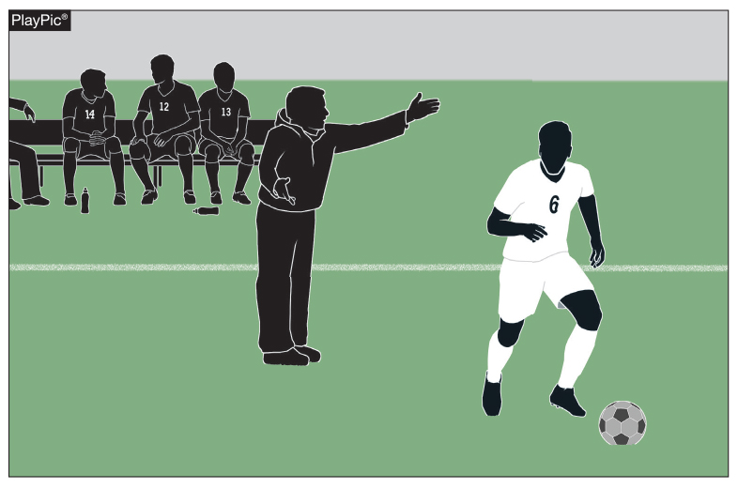
13-2-3: Free Kick: When Awarded
FEDERATION DIFFERENCES
The Referee should blow the play dead at the appropriate time and award an indirect free kick to the opposing team where the ball was when the referee stopped play.
Notes:
13-2-3: Free Kick: When Awarded
The Referee should blow the play dead at the appropriate time and award a an indirect free kick to the opposing team where the ball was when the referee stopped play.

Slide 106
FEDERATION DIFFERENCES
RULE 14 - PENALTY KICK
SUBSTITUTE MAY NOT TAKE THE KICK
FAKING A KICK IS NOT PERMITTED
STUTTER STEP IS PERMITTED WITH NO PAUSE
TEAMMATE OF THE KICKER INFRINGES RULE 14
  BALL GOES INTO GOAL - REKICK
  BALL GOES DIRECTLY OVER GOAL LINE – GOAL KICK
  BALL GOES OVER THE GOAL LINE LAST TOUCHED BY GOALKEEPER –IFK
  GOALKEEPER CATCHES BALL – PLAY CONTINUES

Slide 107
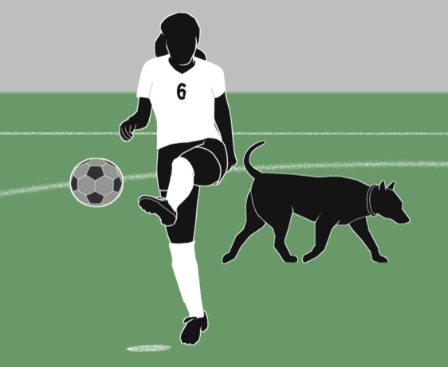
FEDERATION DIFFERENCES
RULE 14 - PENALTY KICK
When, in the taking of a penalty kick, there is an unusual situation that causes a temporary suspension of play before the ball is played or touched by another player, or before the ball hits the goalpost or crossbar, the kick is retaken. Previously, this would have resulted in a drop ball.

Slide 108
Rule 14-1-4 Penalty Kick
FEDERATION DIFFERENCES
Once the kicker starts the approach toward the ball, the kicker may not interrupt his or her movement. Failure to kick the ball as specified will be considered a violation by the attacking team, and the appropriate penalties shall apply.
Legal – Play continues with goalkeeper’s save
Illegal – Indirect Free Kick from Penalty Mark
Notes:
Rule 14-1-4 Penalty Kick
Once the kicker starts the approach toward the ball, the kicker may not interrupt his or her movement. Failure to kick the ball as specified will be considered a violation by the attacking team, and the appropriate penalties shall apply.

Slide 109
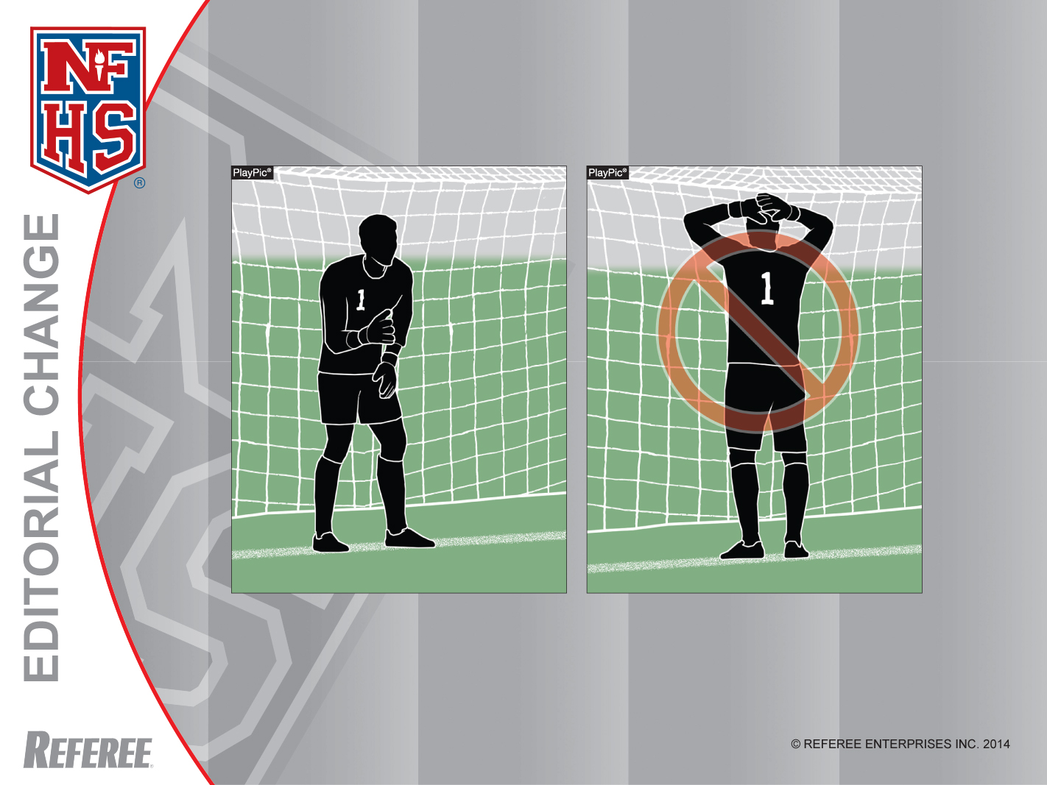
Penalty Kick
Rule 14-1-3
The opposing goalkeeper shall stand on the goal line, facing the kicker, between the goal posts, until the ball is kicked. Lateral movement is allowed, but the goalkeeper is not permitted to come off the line by stepping or lunging forward until the ball is in play.
Notes:
14-1-3 The opposing goalkeeper shall stand on the goal line, facing the kicker, between the goal posts, until the ball is kicked. Lateral movement is allowed, but the goalkeeper is not permitted to come off the line by stepping or lunging forward until the ball is in play.

Slide 110
FEDERATION DIFFERENCES
RULE 14 - PENALTY KICK TO DECIDE A WINNER
1. The overtime will consist of one (1) fifteen-minute period, which will be played in its entirety.
2. A coin toss shall take place to determine which team will put the ball in play first.
3. If the score remains tied following the overtime period, a “shootout” of penalty kicks will determine the winner.
4. The head referee shall choose the goal at which the penalty kicks will be taken.
5. Each coach will select any five (5) eligible players (including goalkeeper) to take the kicks.
6. A coin toss shall be held with the team winning the toss having the choice of kicking first or last in the first round.
7. Teams will then alternate kickers in an A-B-B-A rotation, and there is no follow up on the kicks.

Slide 111
FEDERATION DIFFERENCES
RULE 14 - PENALTY KICK TO DECIDE A WINNER
8. The defending team may change goalkeepers prior to each kick.
9. Following five kicks from each team, the team with the greater number of successful kicks will be given one (1) point and declared the winner.
10. If the same number of penalty kicks are successful for each team, each coach will select five (5) different eligible players who will kick in a “sudden victory” situation. Each team will have an opportunity to kick in each round
of the sudden victory procedure.
11. If there is no sudden victory winner after five (5) kicks, the process will be repeated until a winner is determined.

Slide 112
FEDERATION DIFFERENCES
RULE 15 - THROW IN
IF THE BALL DOES NOT ENTER THE FIELD, THE OPPONENTS ARE AWARDED THE THROW IN
RULE 18 - DEFINITIONS
ALPHABETICAL LIST OF DEFINITIONS

Slide 113
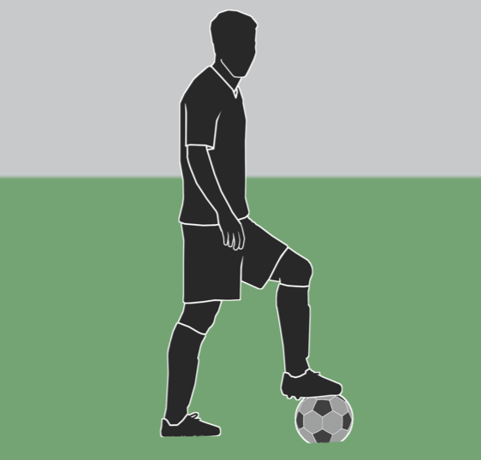
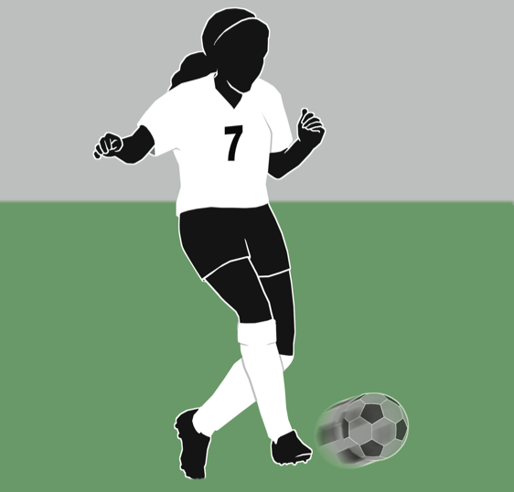
FEDERATION DIFFERENCES
Rule 18-1-1n
Simply tapping the top of the ball with the foot or stepping on the ball is not “putting it in play.” The ball is in play when it has been kicked and moves.

Slide 114
GHSA Online Clinics
GHSA HAS COACHES/REFEREE RECERTIFICATION CLINICS ONLINE
TO BE REGISTERED AS A GHSA REFEREE, YOU MUST TAKE THE CLINIC ONLINE FROM JANUARY 12TH THROUGH FEBRUARY 4th.
ON-LINE RULES EXAM – JANUARY 21st – FEBRUARY 4th.
THE URRL IS:
  http://www.ghsa.net/onlineclinics

Slide 115
QUESTIONS ?

